Slide 1

ACCL23-12 Interview
Presenter: Eric Viklund

Slide 2
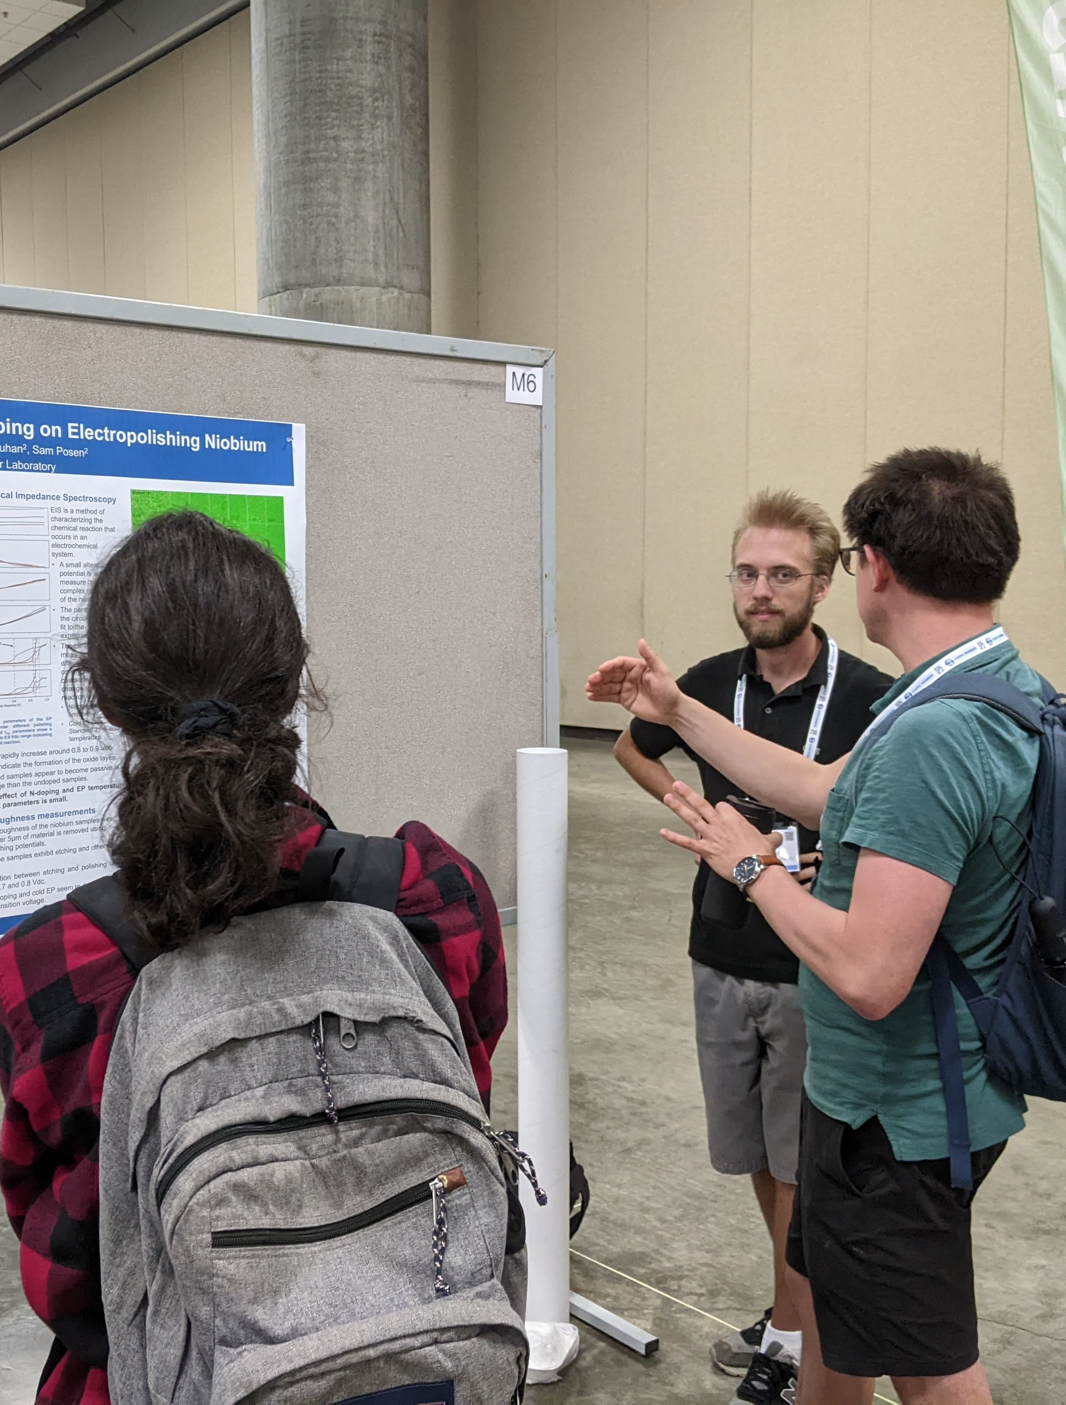
Personal Introduction
Name: Eric Viklund
Contact:
ericviklund2023@u.northwestern.edu
+1(860)834-5008
Education:
B.S. Physics from University of Connecticut
Currently PhD candidate at Northwestern University
Publications
Viklund, Eric, et al. Superconductor Science and Technology 37.2 (2024): 025009.
Viklund, Eric, et al. APL Materials 12.7 (2024).
Viklund, E., et al. IEEE Transactions on Applied Superconductivity 33.5 (2023): 1-4.
Viklund, Eric, et al. No. FERMILAB-CONF-22-825-TD. Fermi National Accelerator Lab.(FNAL), Batavia, IL (United States), 2022.

Slide 3
Outline
Research Experience
Study on the Electrochemical Polishing Process Applied to Niobium SRF Cavities
Development of a Mechanical Polishing Process for Nb₃Sn Coated SRF Cavities
Development of a New Recoating Procedure to Heal Nb₃Sn Cavities.
Research Proposal
Cost Reduction Methods for Niobium SRF Cavity Fabrication
Study on the HF-Free Bipolar Electrochemical Polishing Method

Slide 4
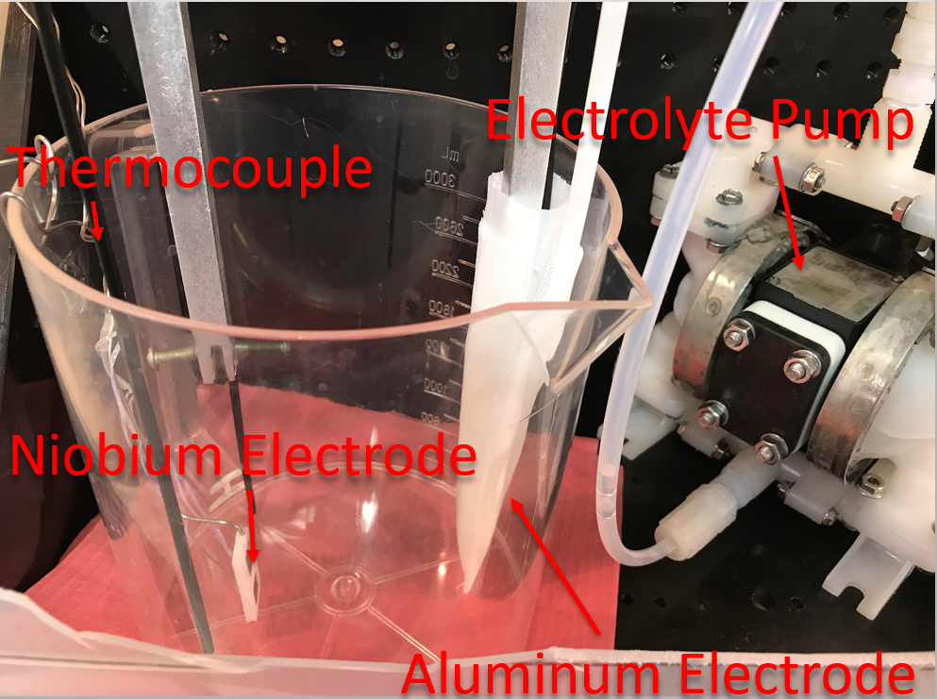
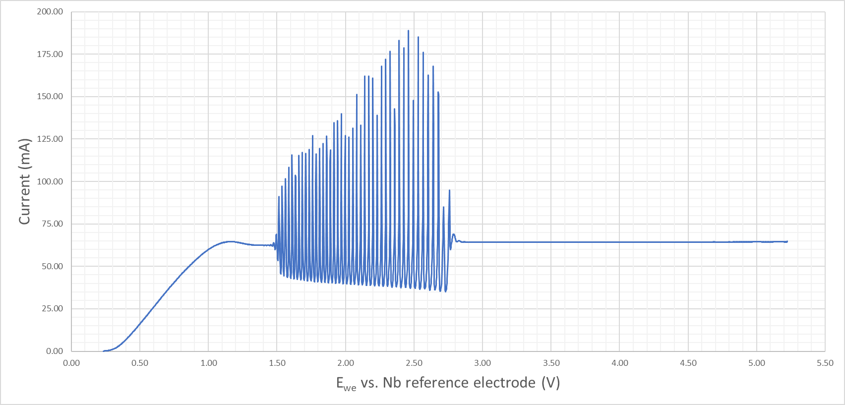
Electropolishing Study
Etching and pitting sometimes occur in nitrogen doped niobium cavities.
A better understanding of EP necessary to understand and prevent these defects.
Sample study to test different polishing parameters.
Applied voltage
Electrolyte temperature
Nitrogen doping

Slide 5
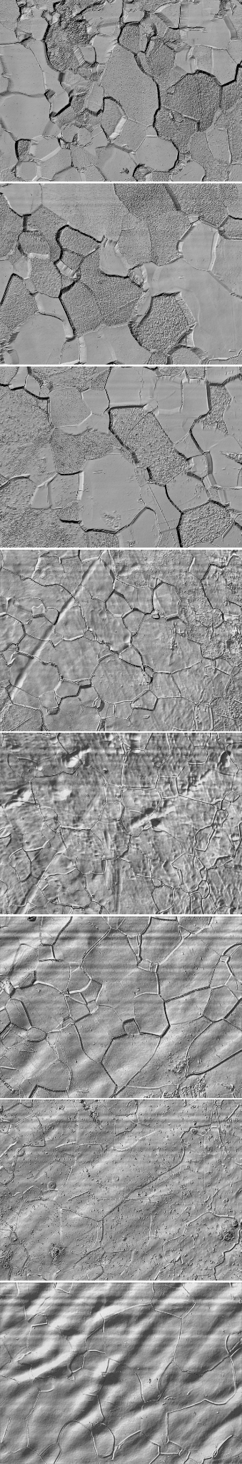
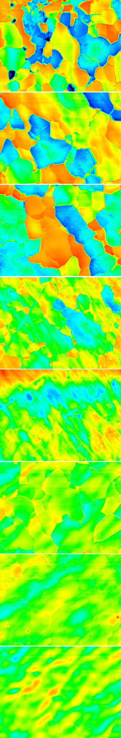
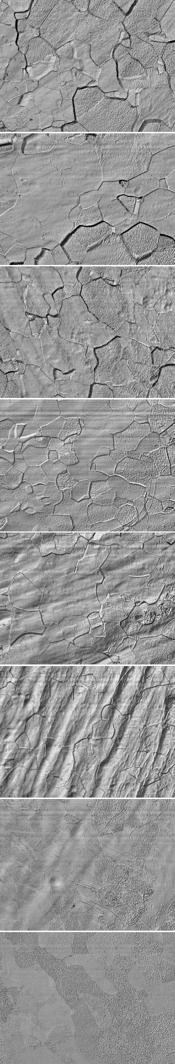
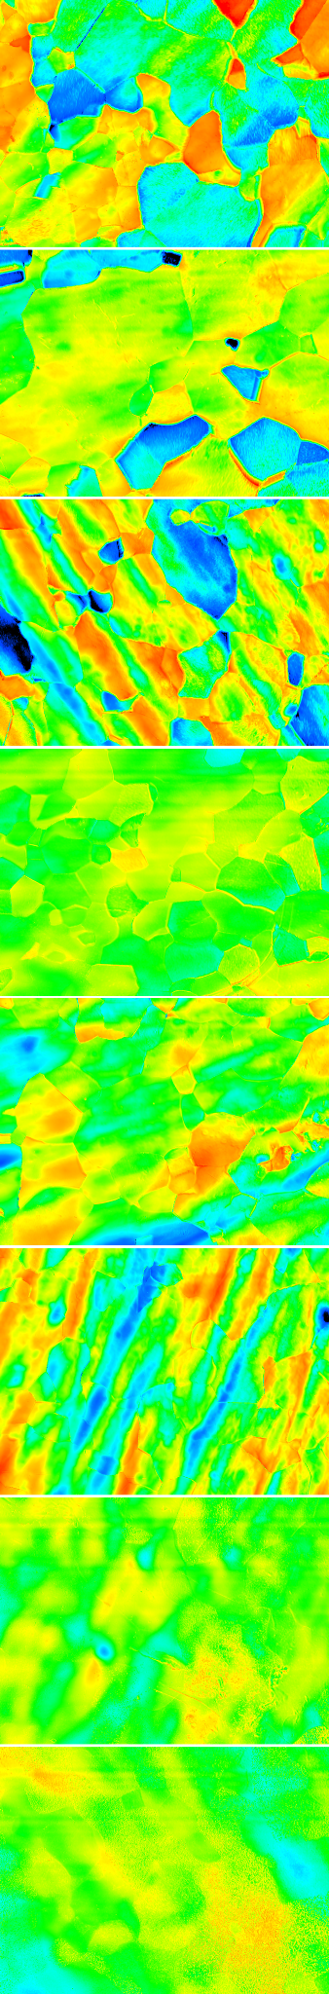
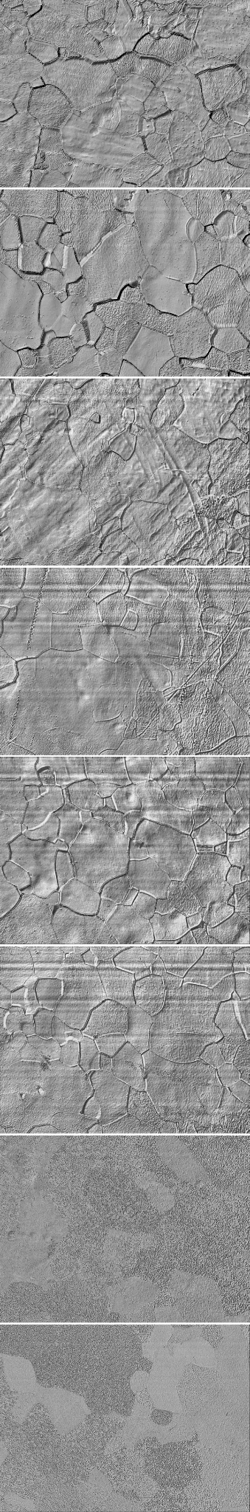
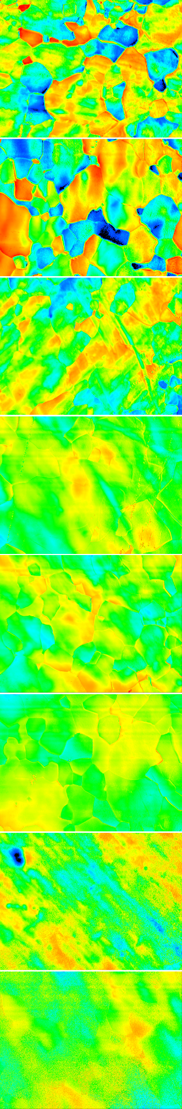
Surface Analysis of Electropolished Samples
Etching was caused by low polishing voltage.
Nitrogen doping shows no effect on etching.
Temperature has no direct impact but can cause an ohmic voltage drop in the electrolyte due to high currents.
Increased voltage and cathode surface area required to prevent etching.
Voltage
0.5
0.6
0.7
0.8
0.9
1.0
1.1
1.2
Voltage
0.5
0.6
0.7
0.8
0.9
1.0
1.1
1.2
Undoped
Undoped
Nitrogen Doped
Nitrogen Doped
Nitrogen Doped Cold EP
Nitrogen Doped Cold EP

Slide 6
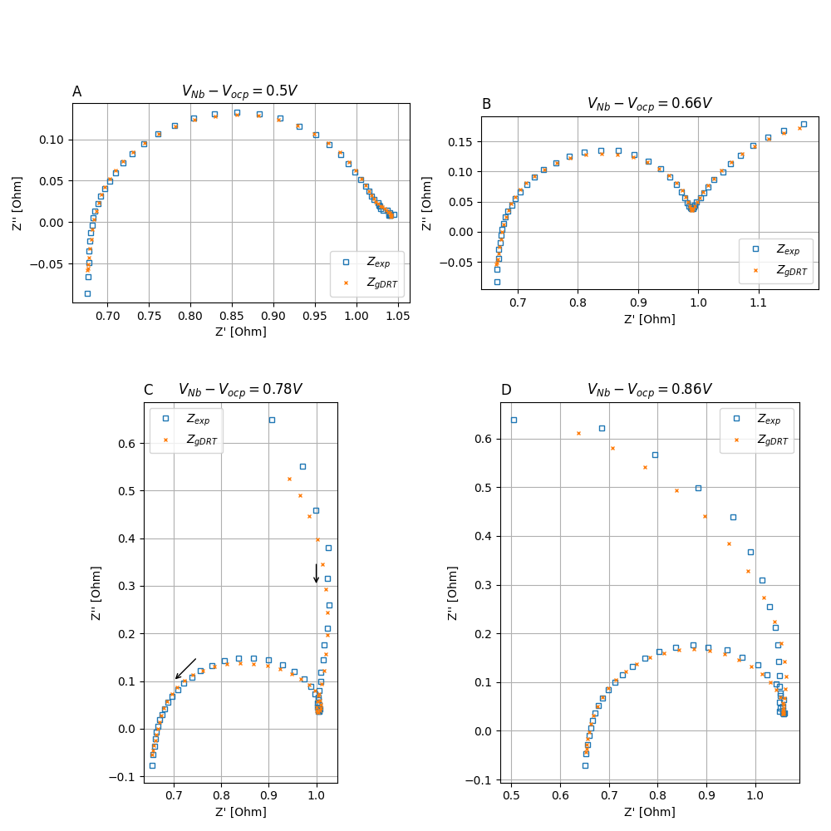
Electrochemical Impedance Spectroscopy
Electrochemical impedance spectroscopy (EIS)
A small alternating voltage is applied.
Electrical impedance spectrum is measured.
Impedance spectrum gives information on the chemical processes on the electrode.
How do we interpret this data?

Slide 7
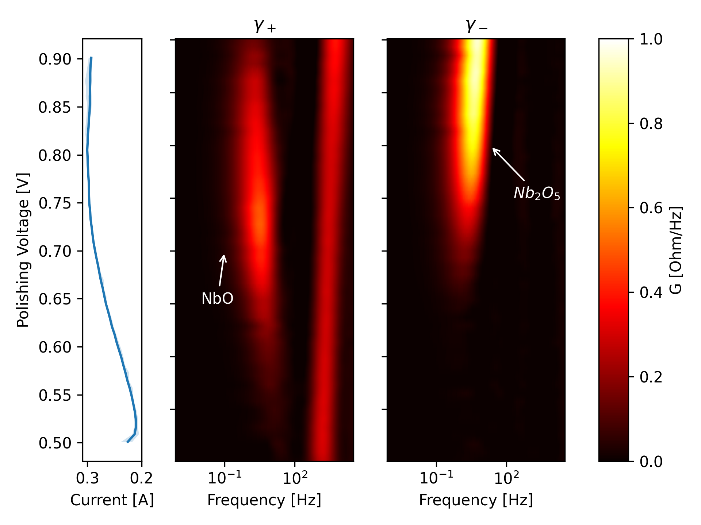
Data Analysis Using Distribution of Relaxation Times Fitting
Distribution of Relaxation Times
Calculate the relaxation time of different surface processes.
Three distinct relaxation times
Double layer capacitance
Low voltage NbO oxidation peak
High voltage Nb₂O₅ oxidation peak

Slide 8
Nb₂O₅ Oxidation Effect on Surface Finish
0.5
0.6
0.7
0.8
0.9
1.0
1.1
1.2

Slide 9
Beyond Niobium – Nb₃Sn Thin Film Cavities
 | Nb | Nb₃Sn | Difference
Q_{@4K,1.3GHz} | ~10⁹
E_{max} | 50 MV/m

Slide 10
Beyond Niobium – Nb₃Sn Thin Film Cavities
 | Nb | Nb₃Sn | Difference
Q_{@4K,1.3GHz} | ~10⁹ | ~10¹⁰ | 10x
E_{max} | 50 MV/m | 100 MV/m | 2x

Slide 11
Beyond Niobium – Nb₃Sn Thin Film Cavities
 | Nb | Nb₃Sn | Difference
Q_{@4K,1.3GHz} | ~10⁹ | ~10¹⁰ | 10x
E_{max} | 50 MV/m | ~20 MV/m | 2x

Slide 12
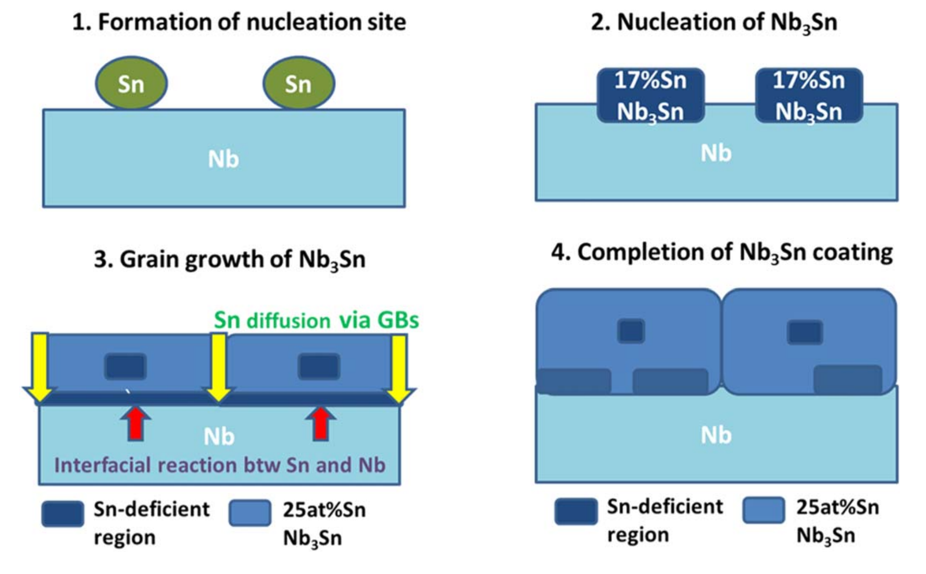
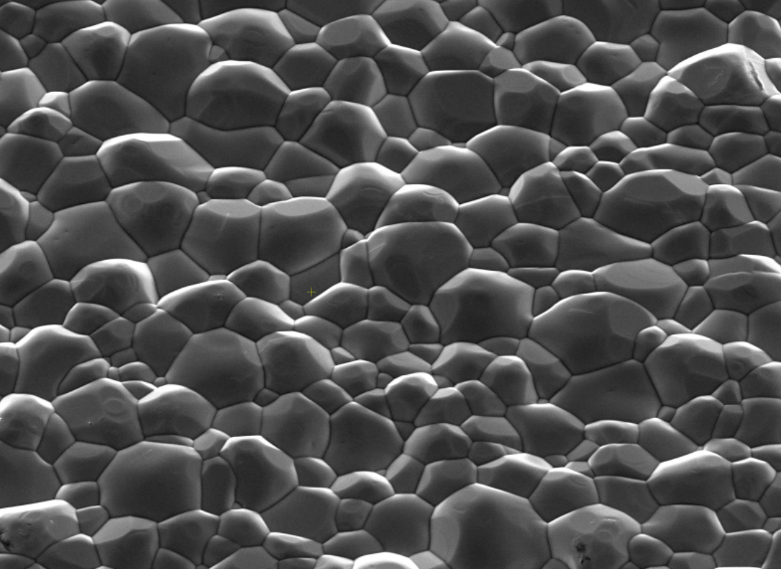
Challenges of Nb₃Sn Cavity Fabrication
Lee, Jaeyel, et al. Superconductor Science and Technology 32.2 (2018): 024001.
Viklund, Eric, et al. Superconductor Science and Technology 37.2 (2024): 025009.
Nb₃Sn is deposited by Sn vapor-diffusion.
Stoichiometry is important.
Nb₃Sn too thin to be electropolished.
3 μm

Slide 13
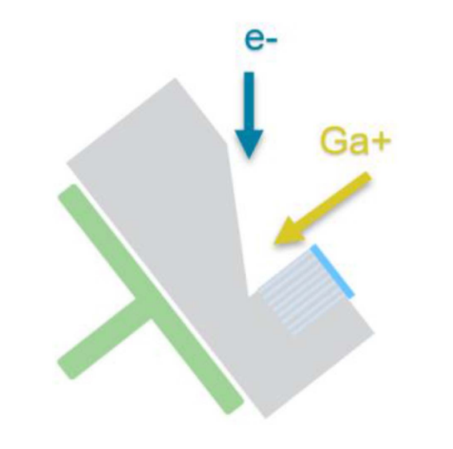
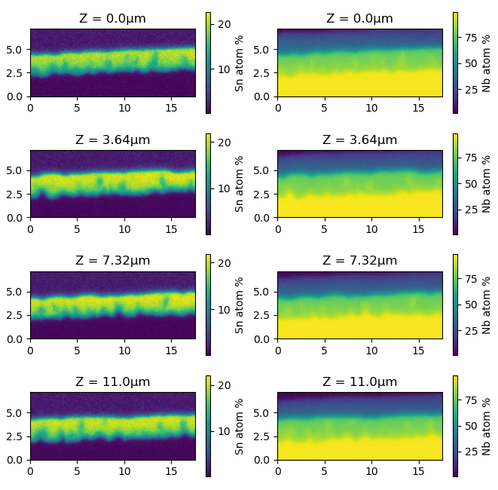
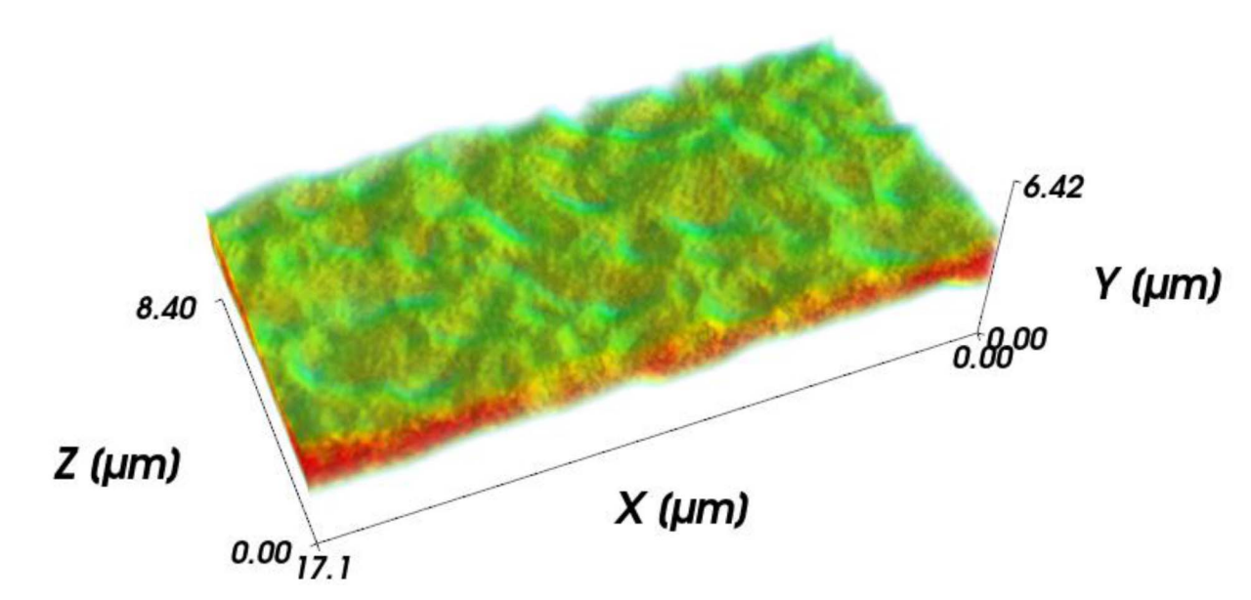
Investigation of Sn Deficient Regions Using 3D Tomography
Pt Cap
Y
Nb₃Sn
Bulk Nb
Z
X
Viklund, E., et al. IEEE Transactions on Applied Superconductivity 33.5 (2023): 1-4.

Slide 14
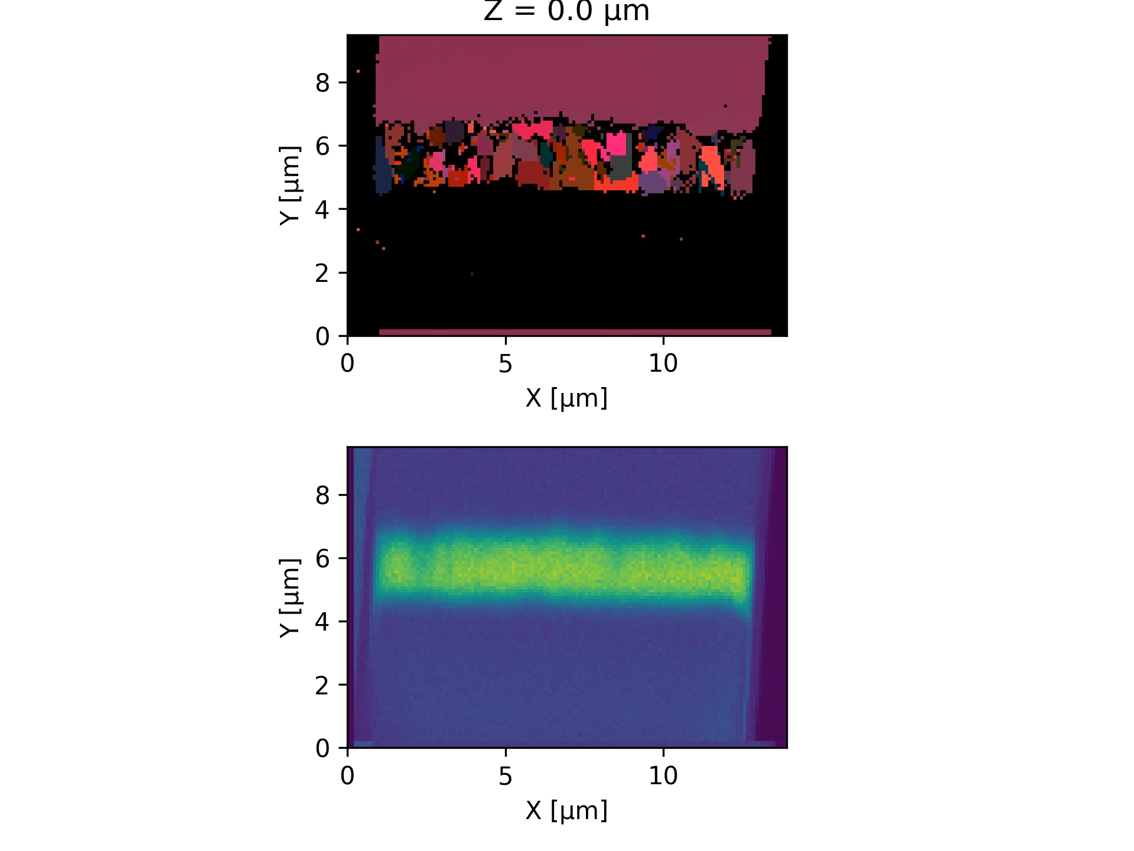
Combined 3D EDS and EBSD
EDS shows Sn distribution within the film.
EBSD shows the grain structure of the film.
Sn deficient are shown to be intra granular as suggested by the Sn nucleation model.

Slide 15
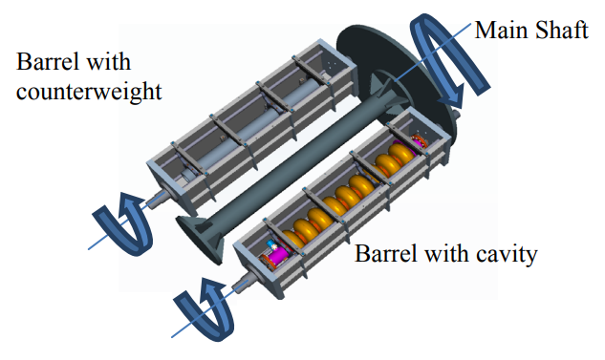
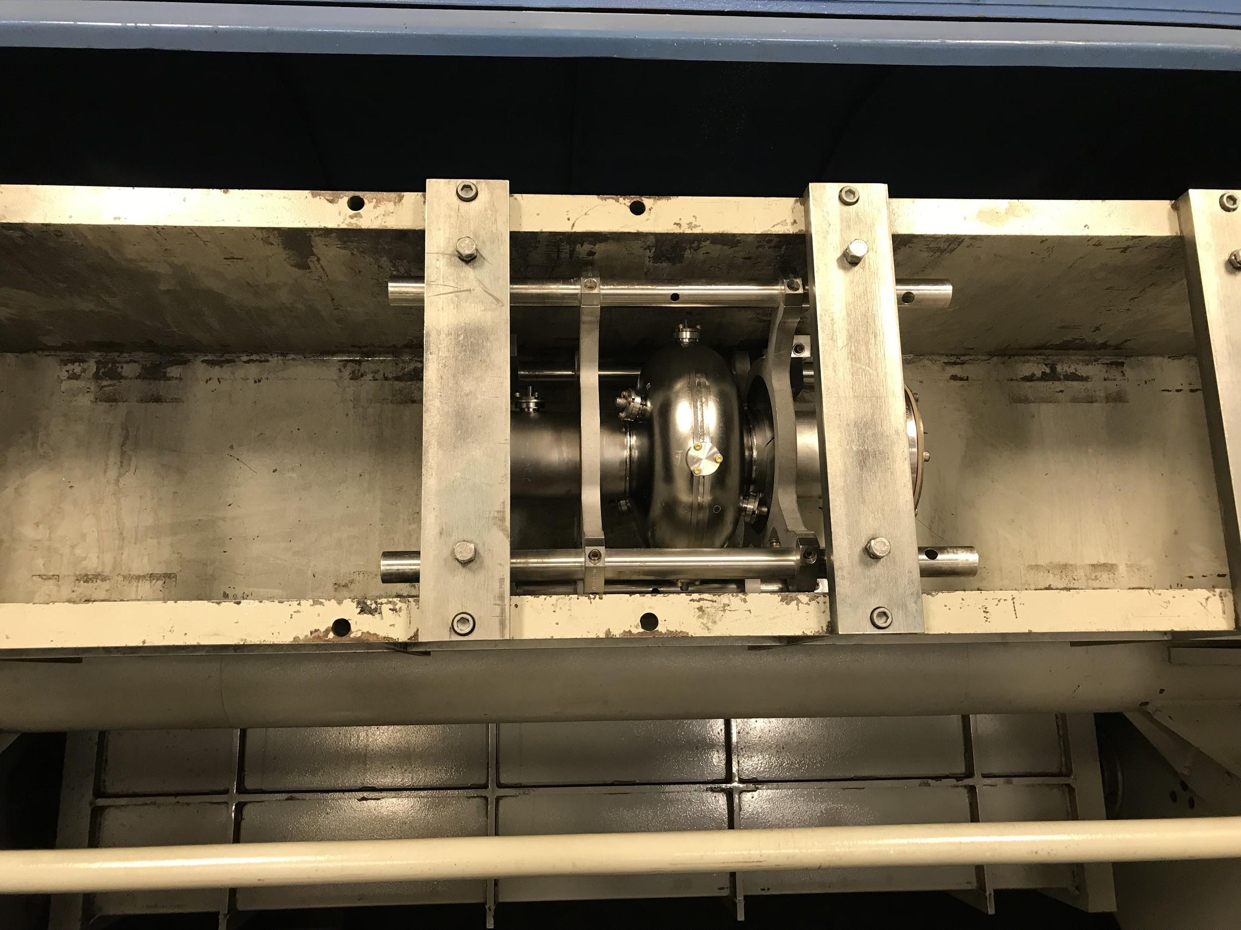
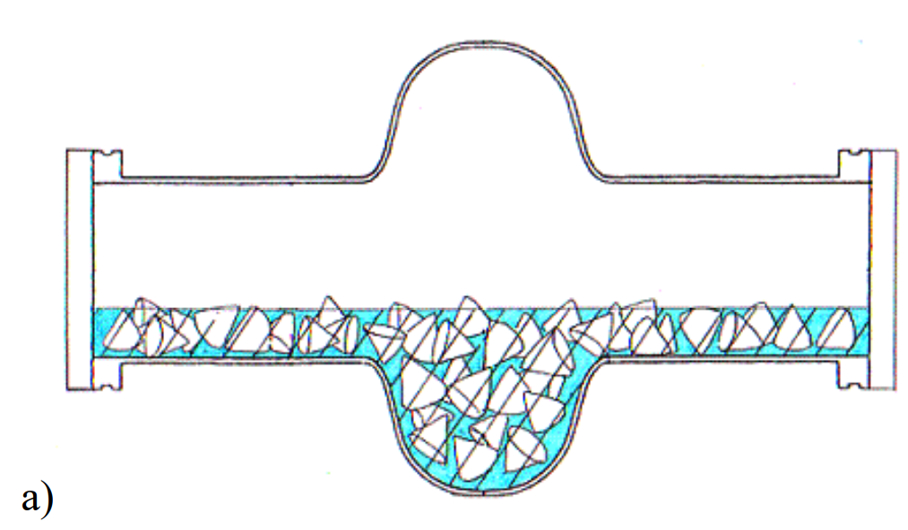
Centrifugal Barrel Polishing (CBP)

Slide 16
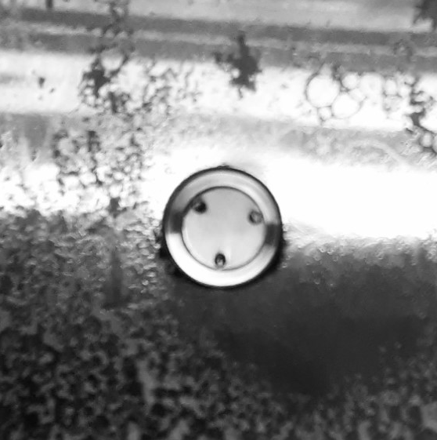
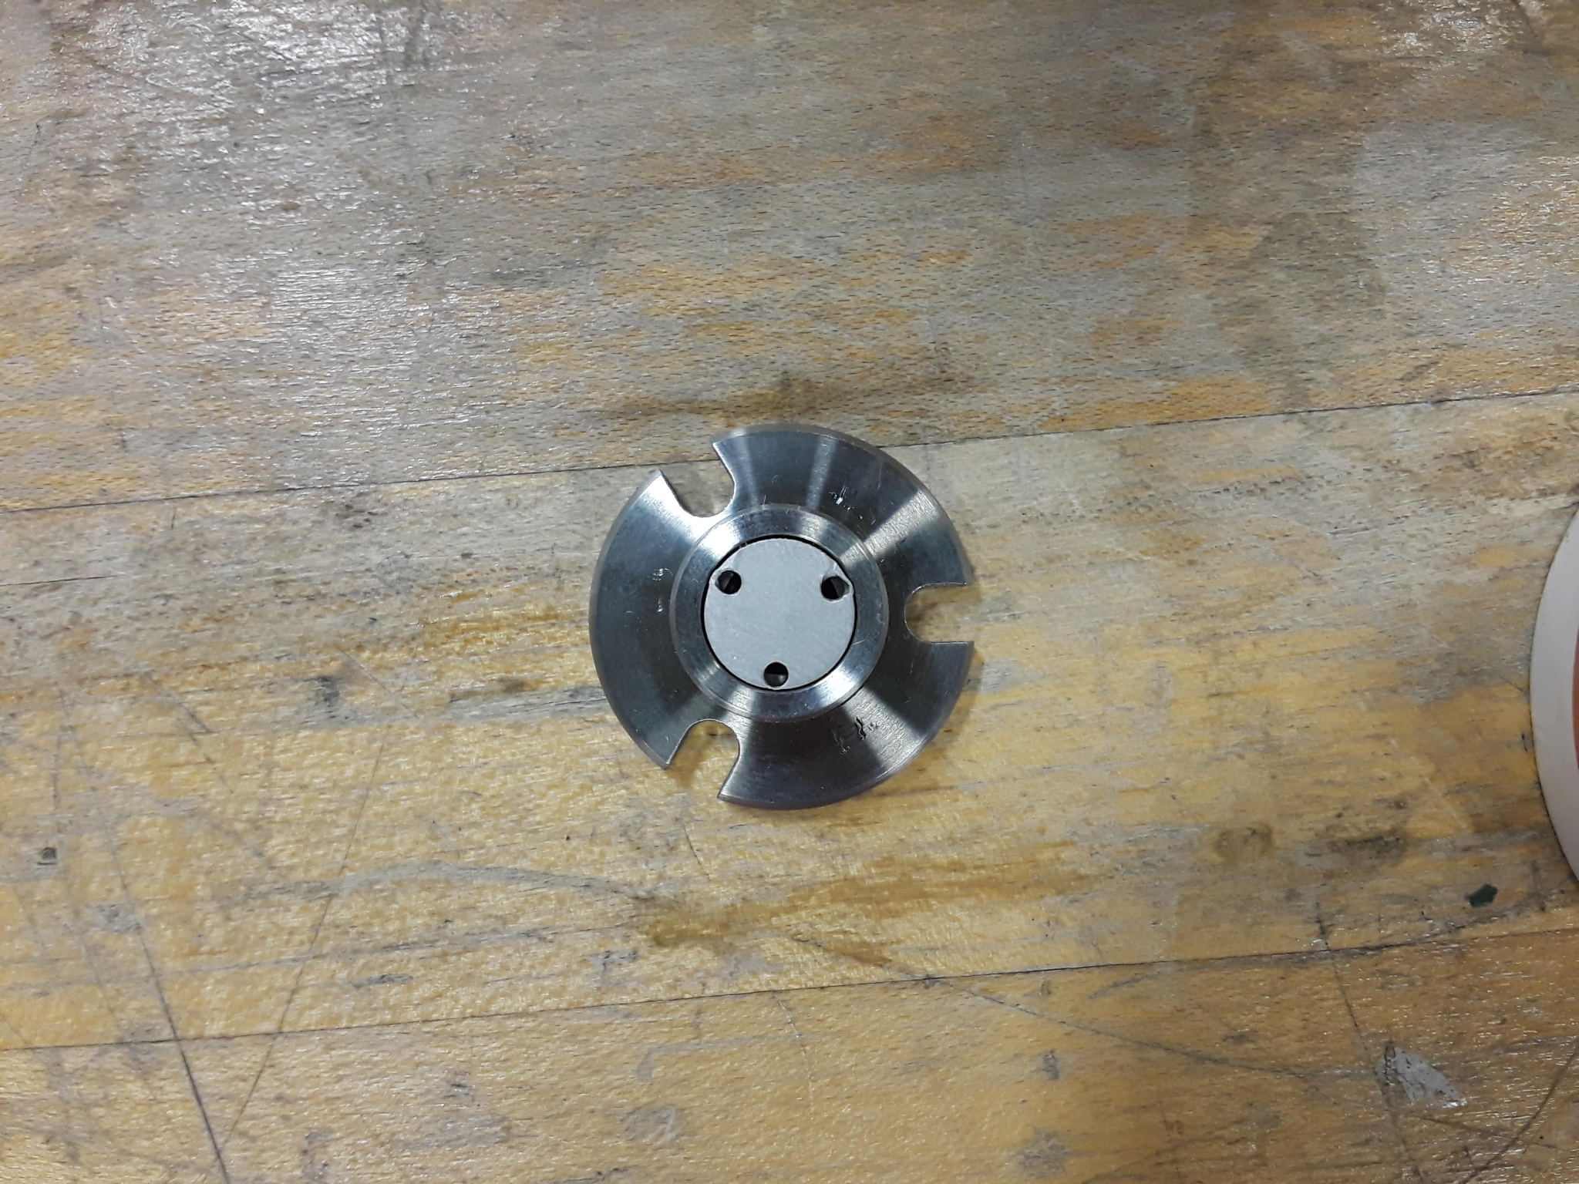
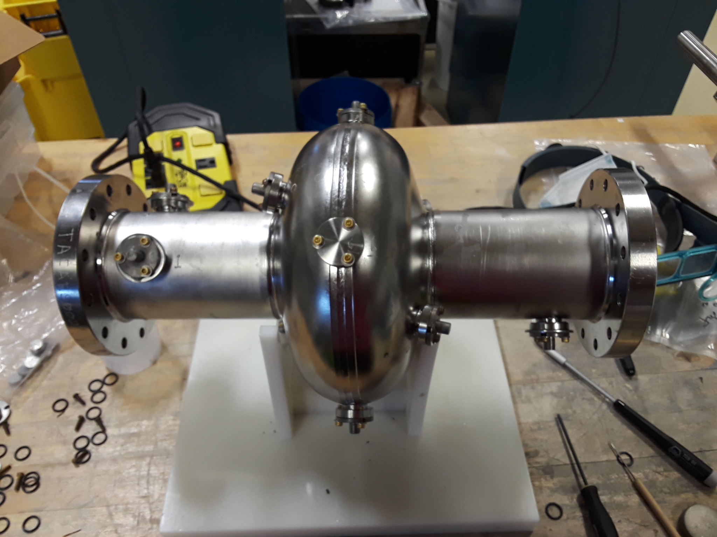
Nb₃Sn Sample Polishing Using a Coupon Cavity
1 cm Nb₃Sn coated sample
Internal View

Slide 17
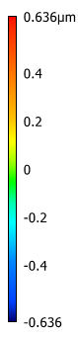
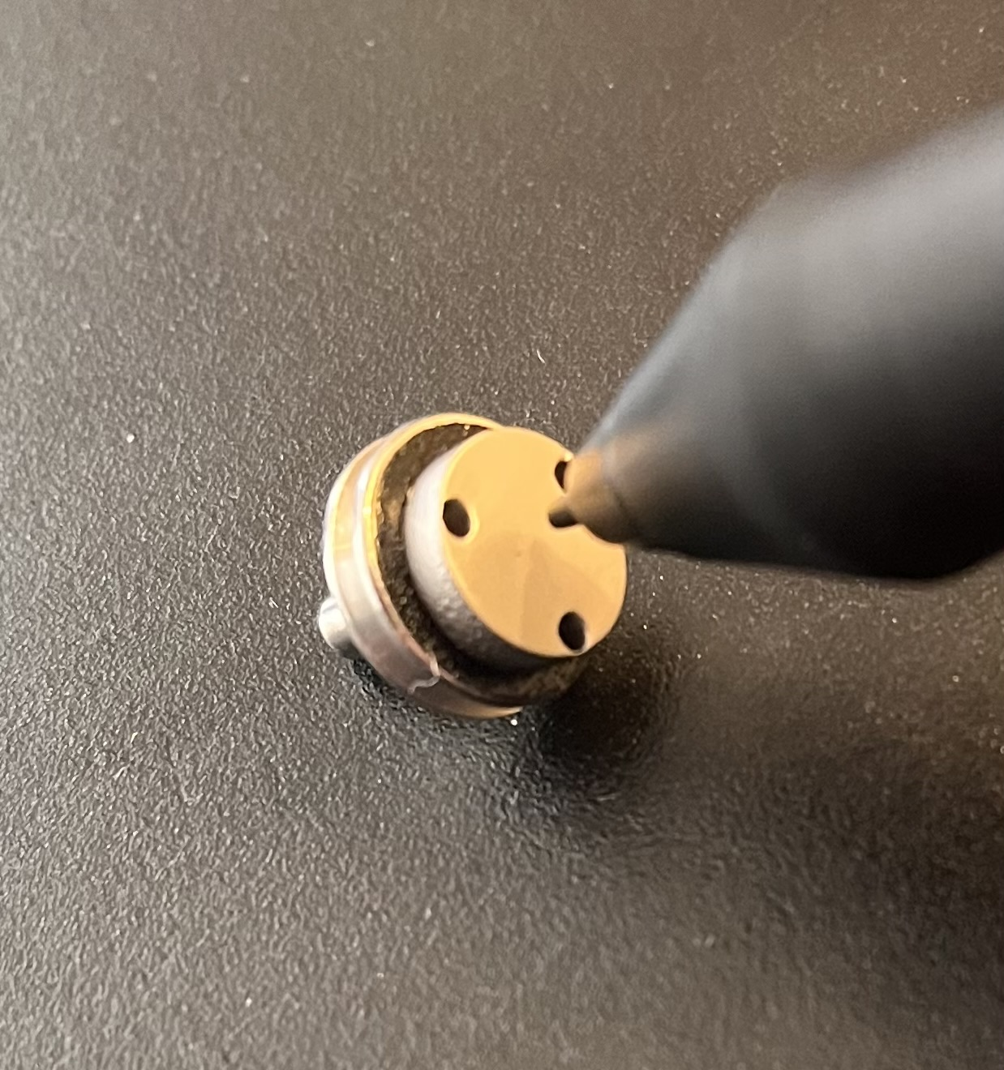
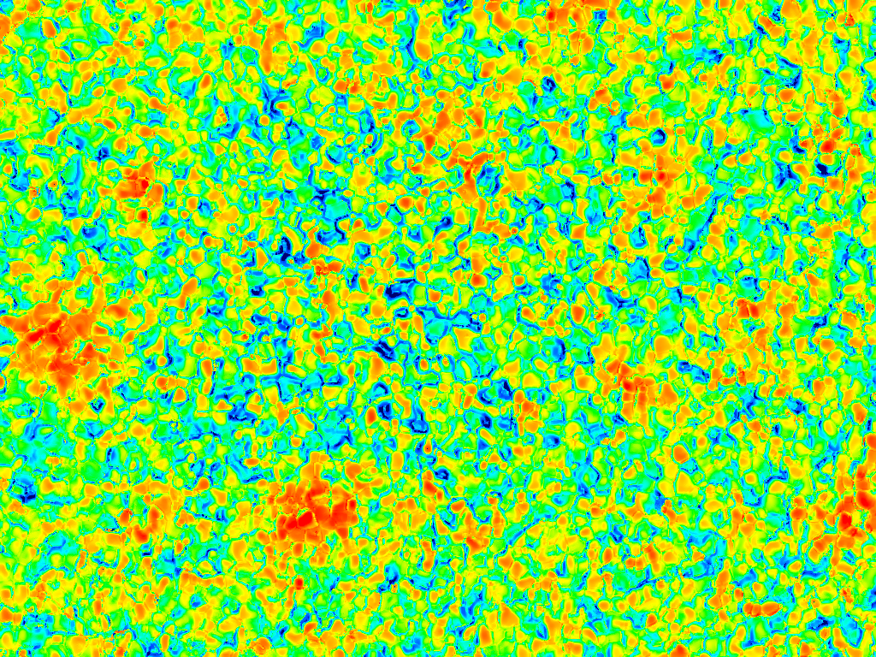
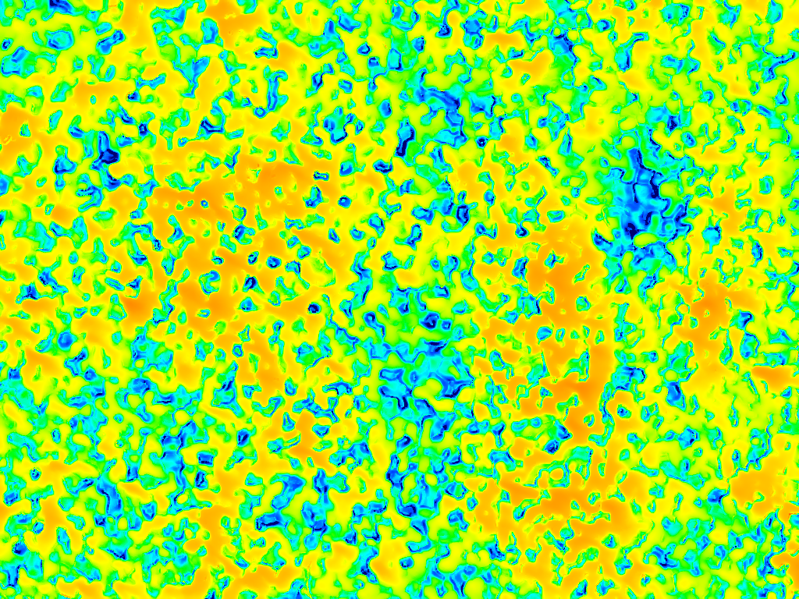
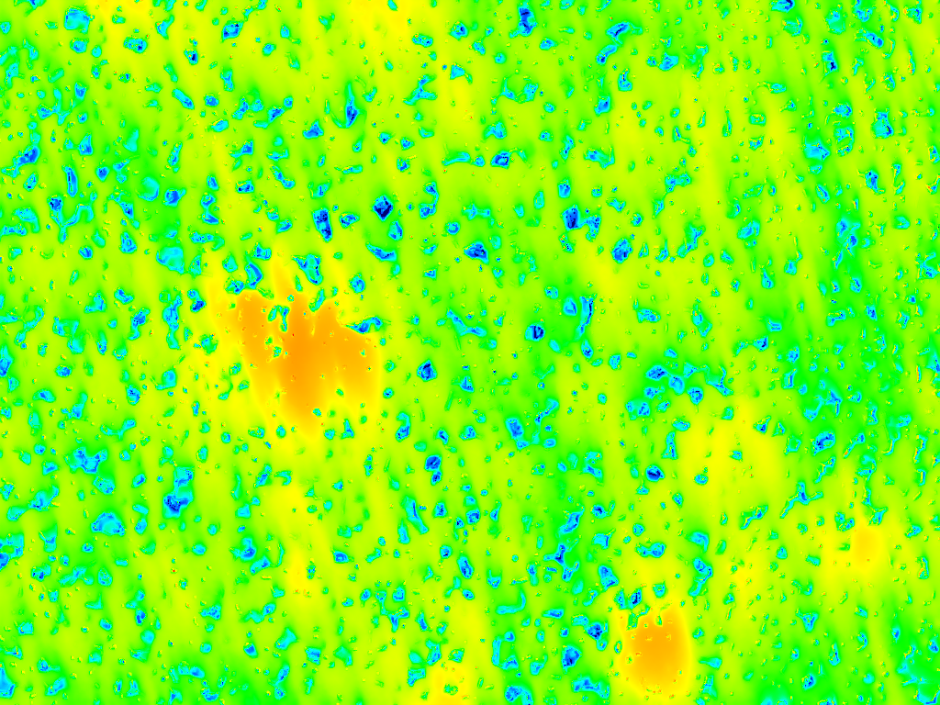
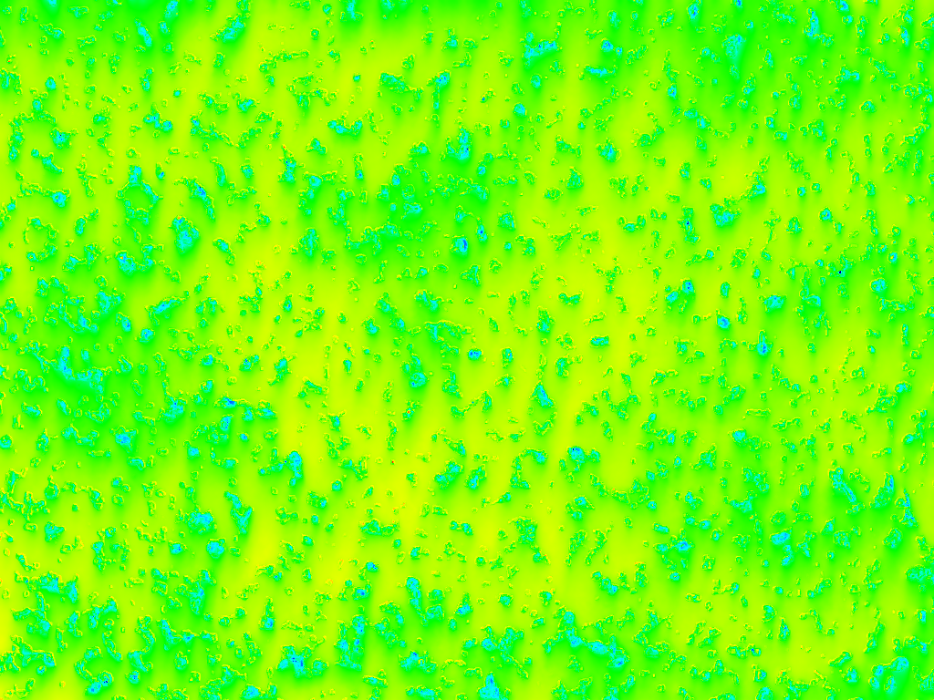
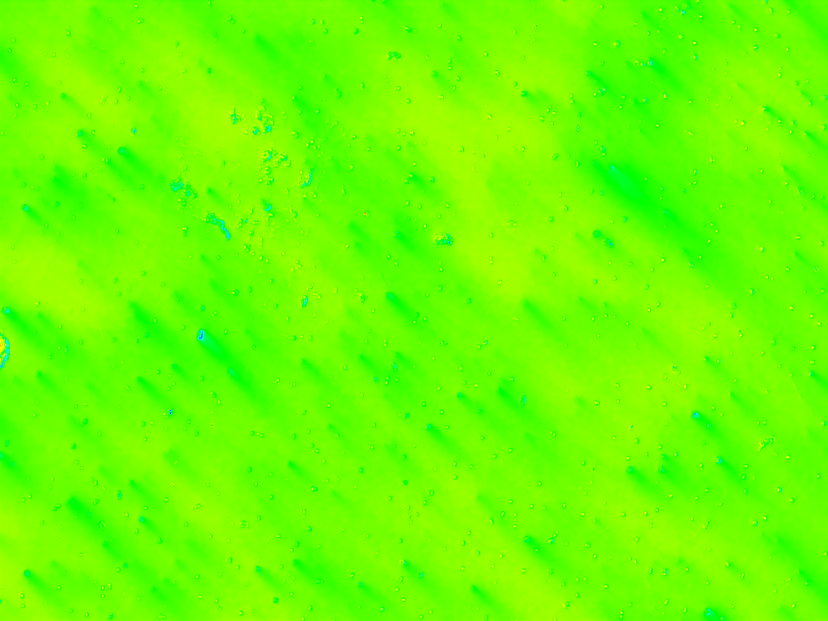
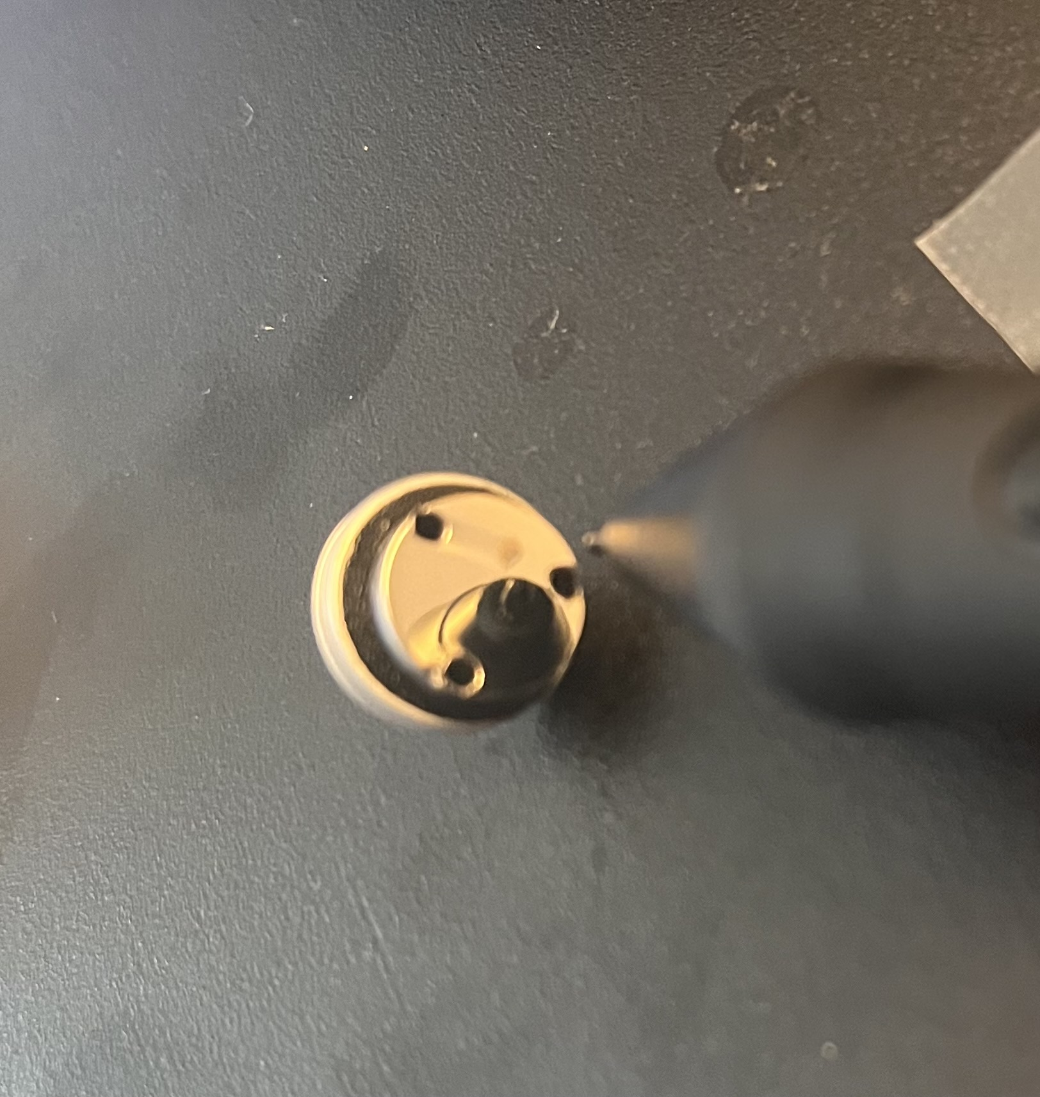
0 hours
2 hours
4 hours
6 hours
8 hours
Viklund, Eric, et al. Superconductor Science and Technology 37.2 (2024): 025009.
86 μm

Slide 18
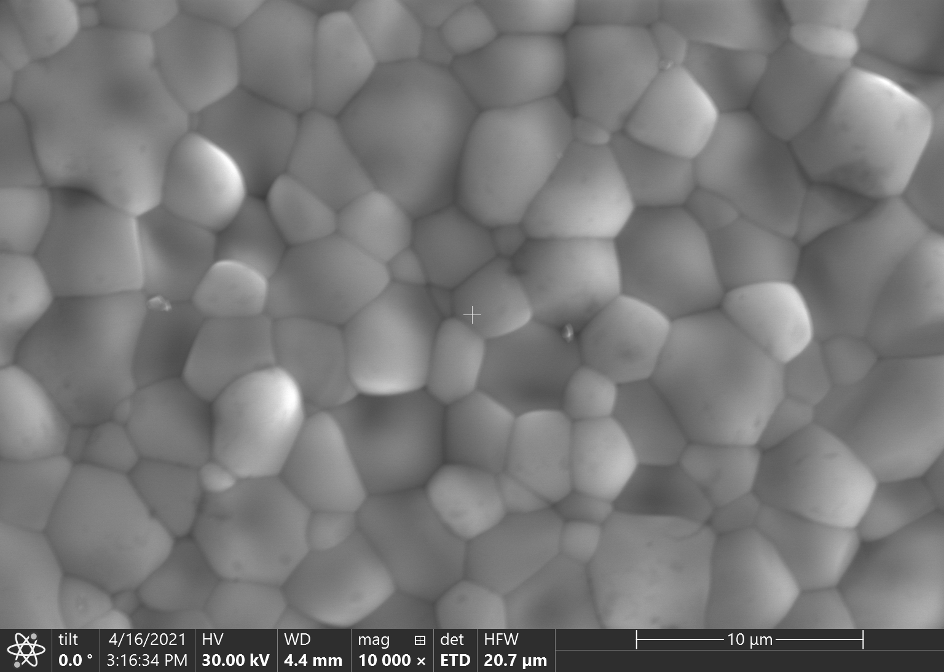
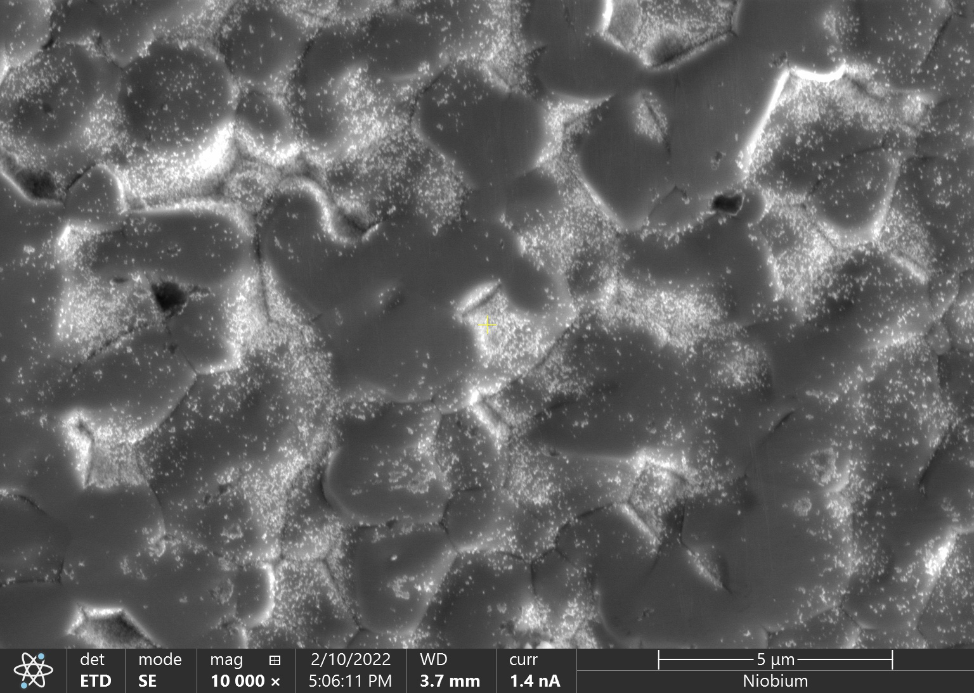
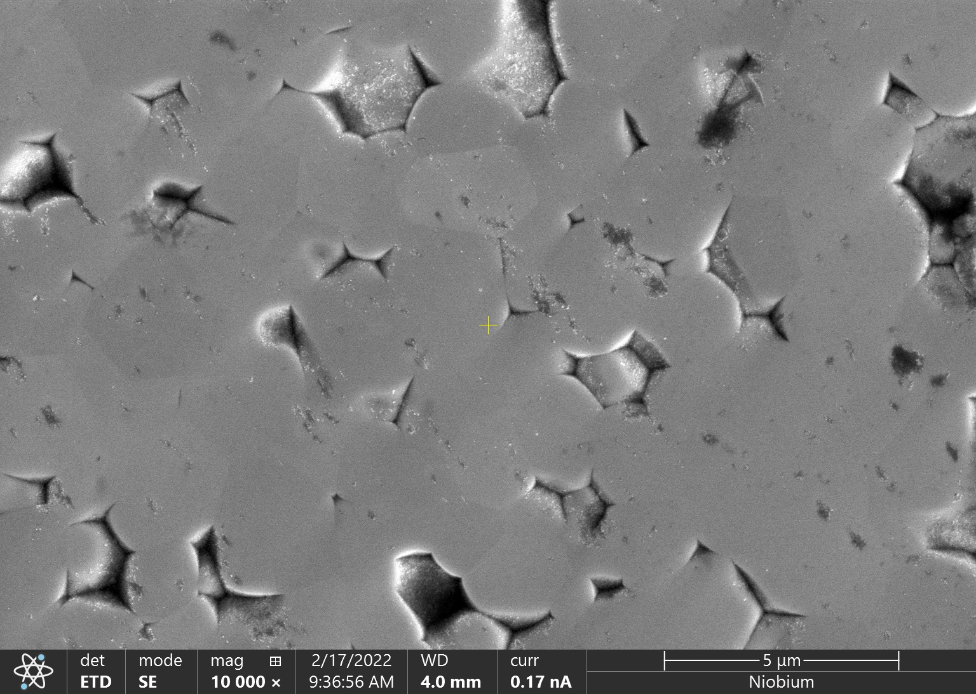
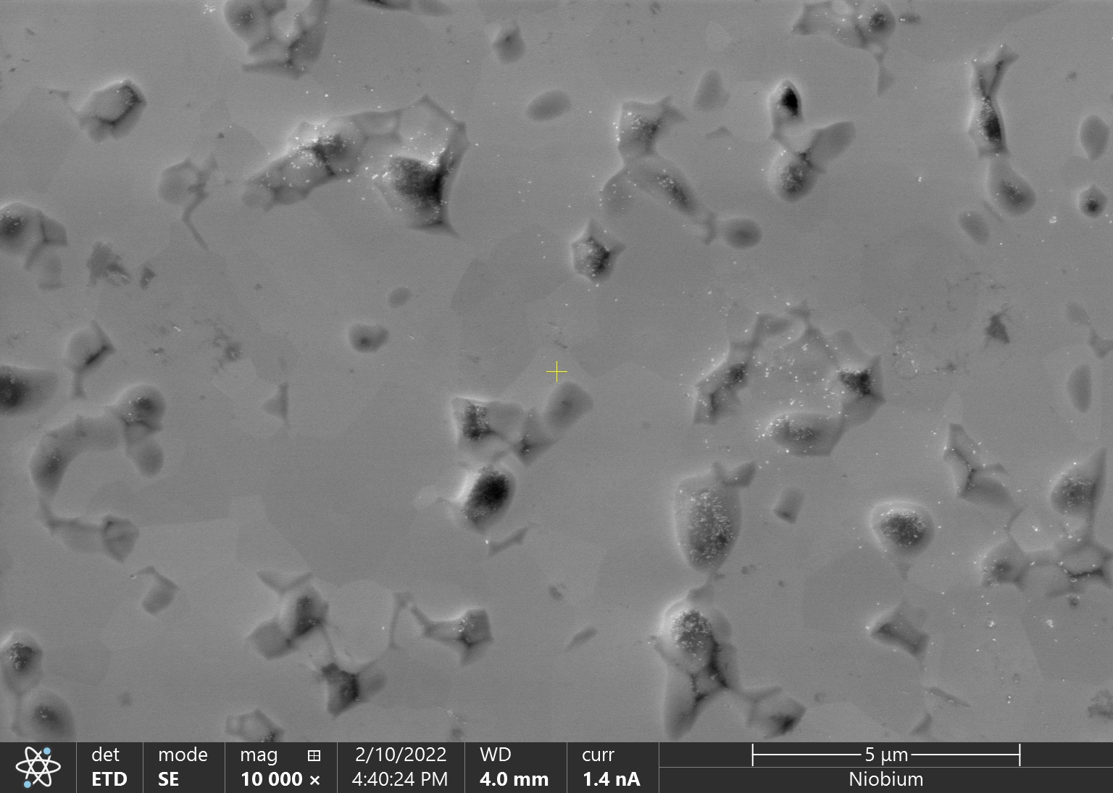
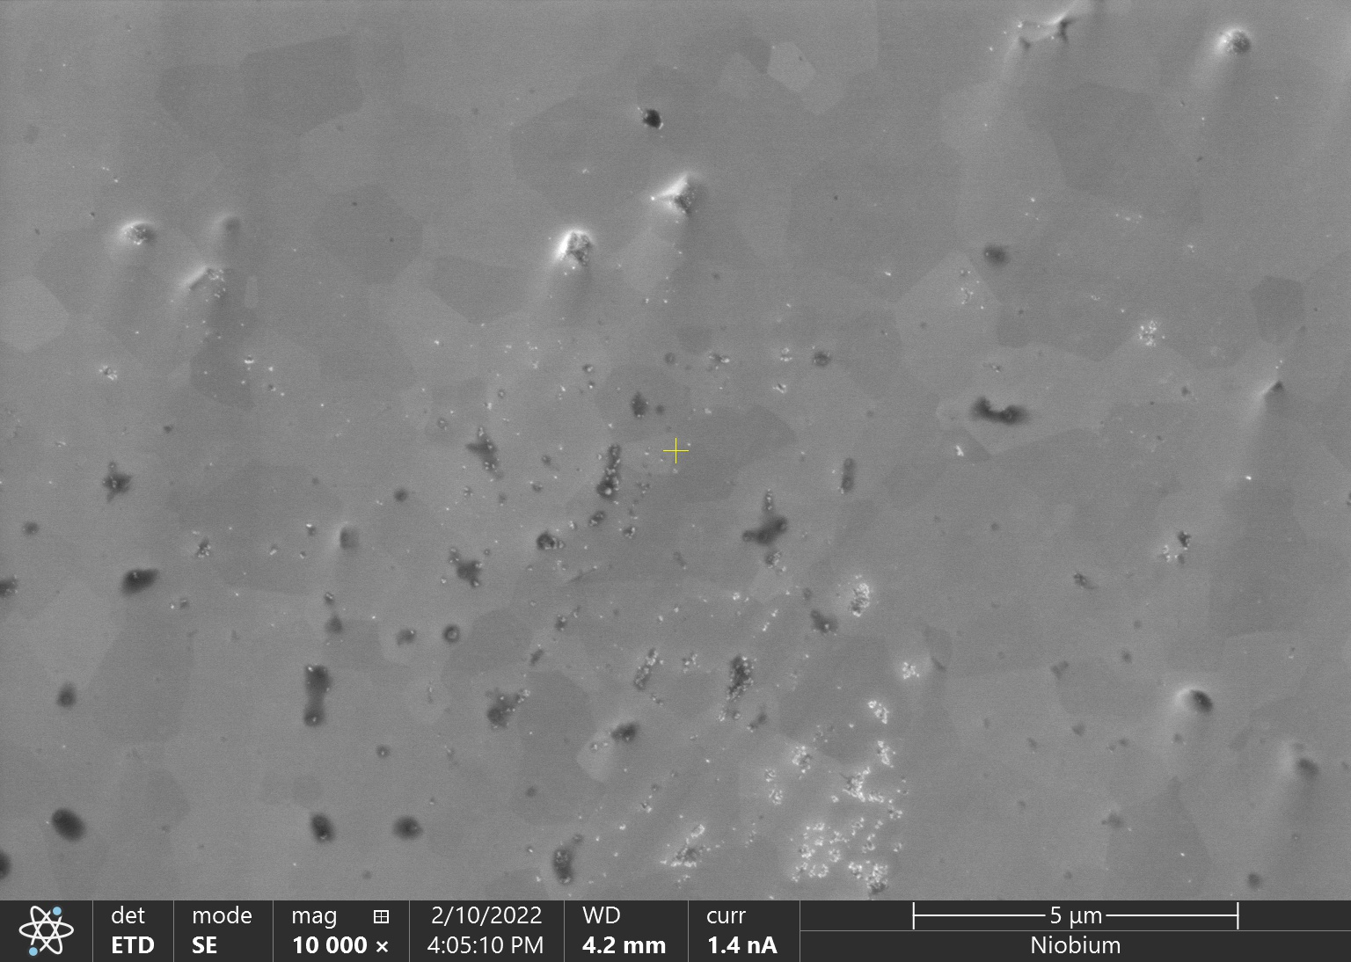
Initial Surface
2 hours
5 μm
5 μm
4 hours
6 hours
8 hours
5 μm
5 μm
5 μm
Viklund, Eric, et al. Superconductor Science and Technology 37.2 (2024): 025009.

Slide 19
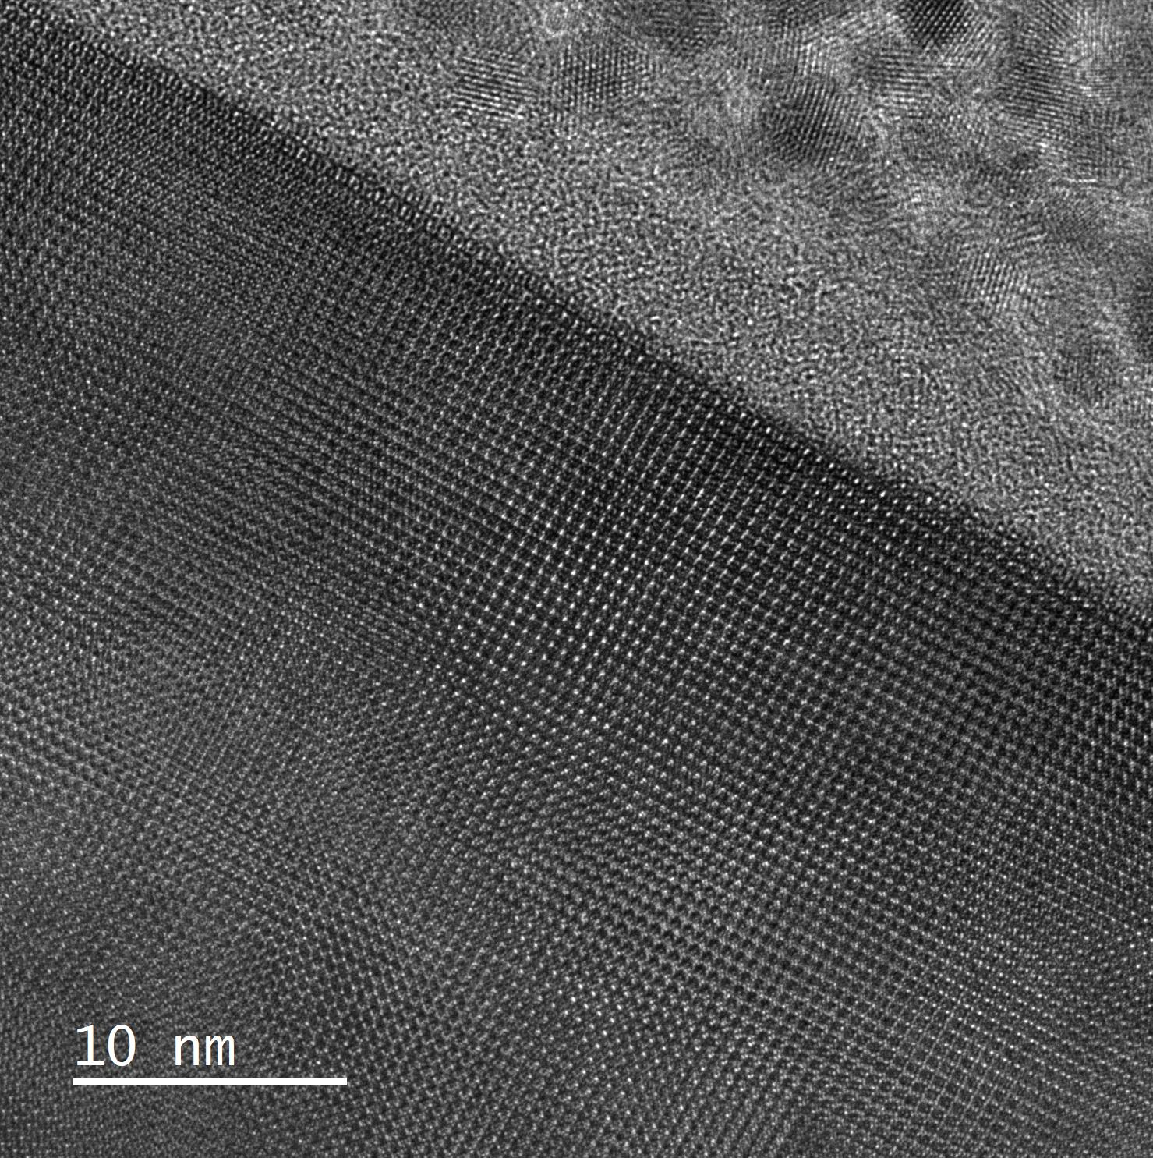
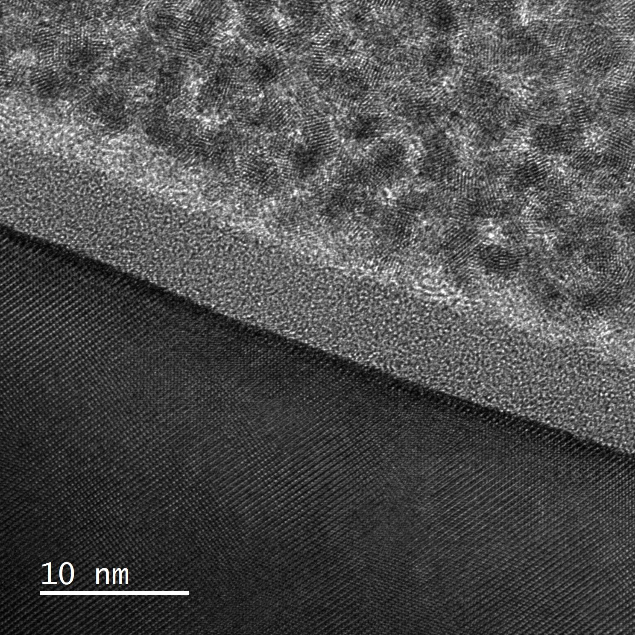
Nanoscale Image of a Polished Nb₃Sn Thin Film
Pt Cap
Pt Cap
Oxide Layer
Oxide Layer
Nb₃Sn
Nb₃Sn
Viklund, Eric, et al. Superconductor Science and Technology 37.2 (2024): 025009.

Slide 20
CBP Surface Roughness and Removal Rate
~170 nm/hr
Typical Niobium Cavity
Viklund, Eric, et al. Superconductor Science and Technology 37.2 (2024): 025009.

Slide 21
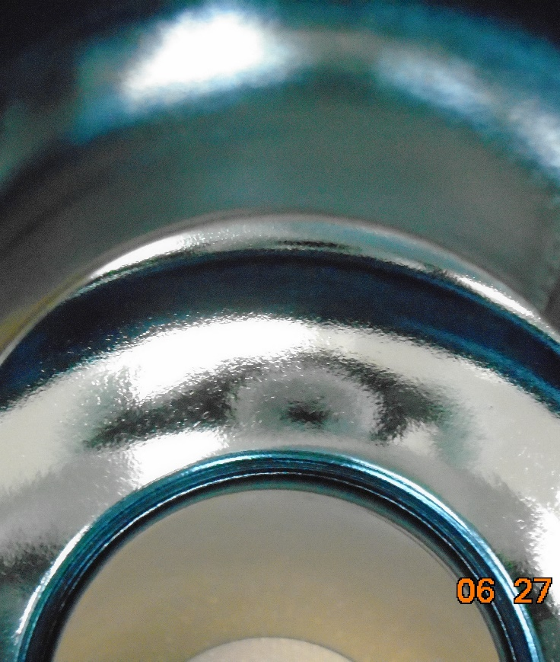
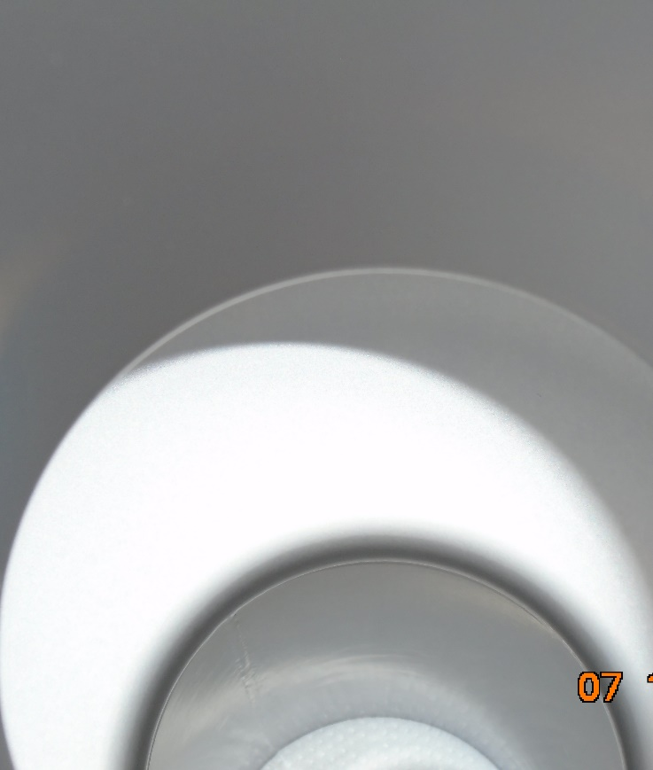
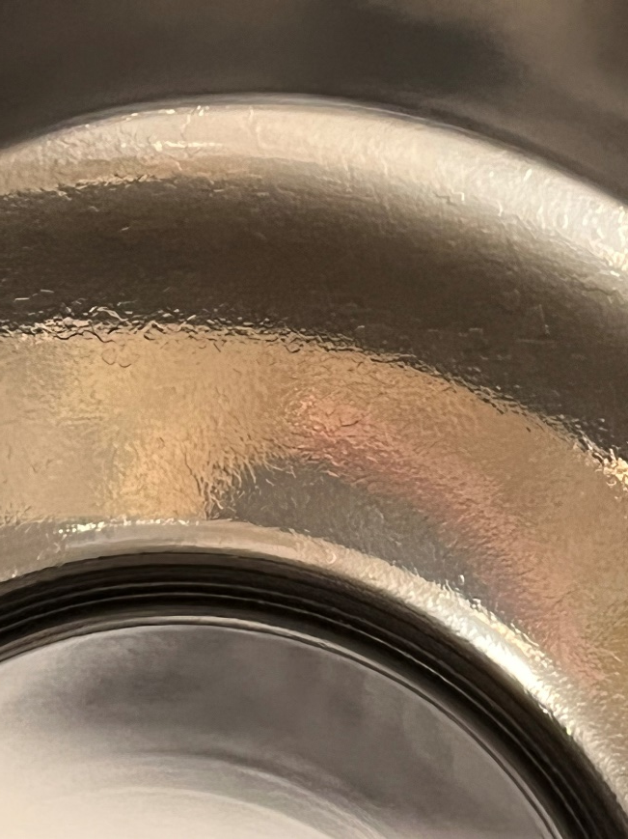
Applying Centrifugal Barrel Polishing (CBP) to a Nb₃Sn Cavity
Before Nb₃Sn Coating
After Nb₃Sn Coating
After Polishing
Nb₃Sn
4-hour CBP

Slide 22
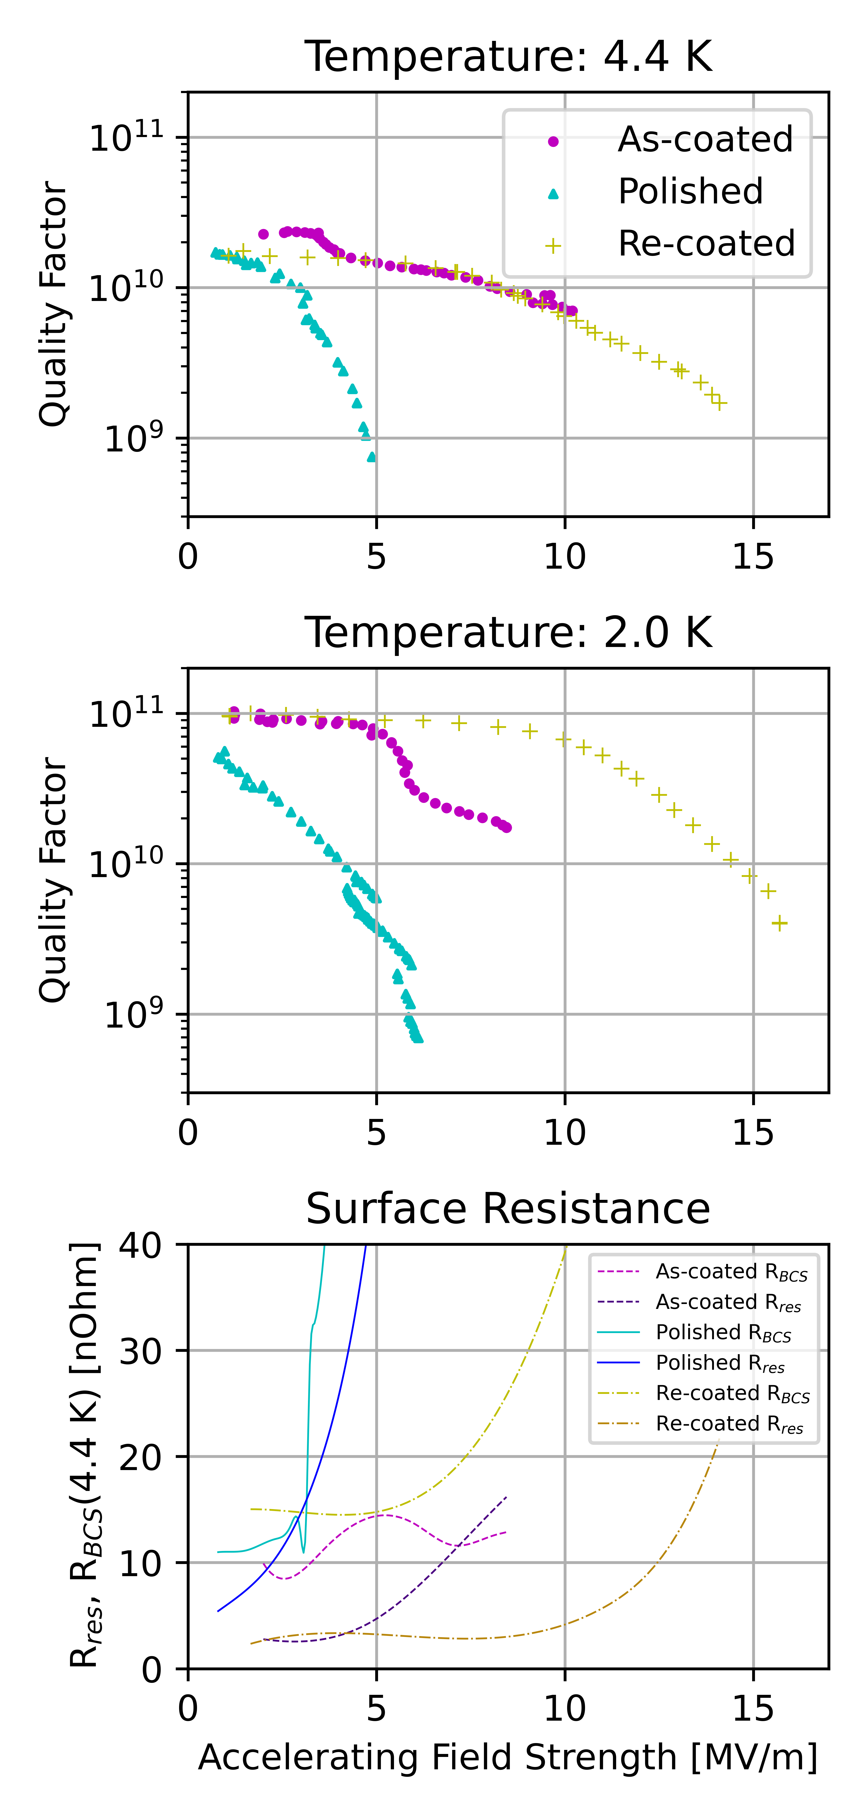
Performance of a Mechanically Polished Nb3Sn SRF Cavity
Polishing initially causes degradation.
A second coating is applied to fix the degradation.
Max accelerating field increases.
10 MV/m to 14 MV/m
Quality factor stays the same.
First successful application of mechanical polishing to a Nb₃Sn cavity!
Viklund, Eric, et al. Superconductor Science and Technology 37.2 (2024): 025009.

Slide 23
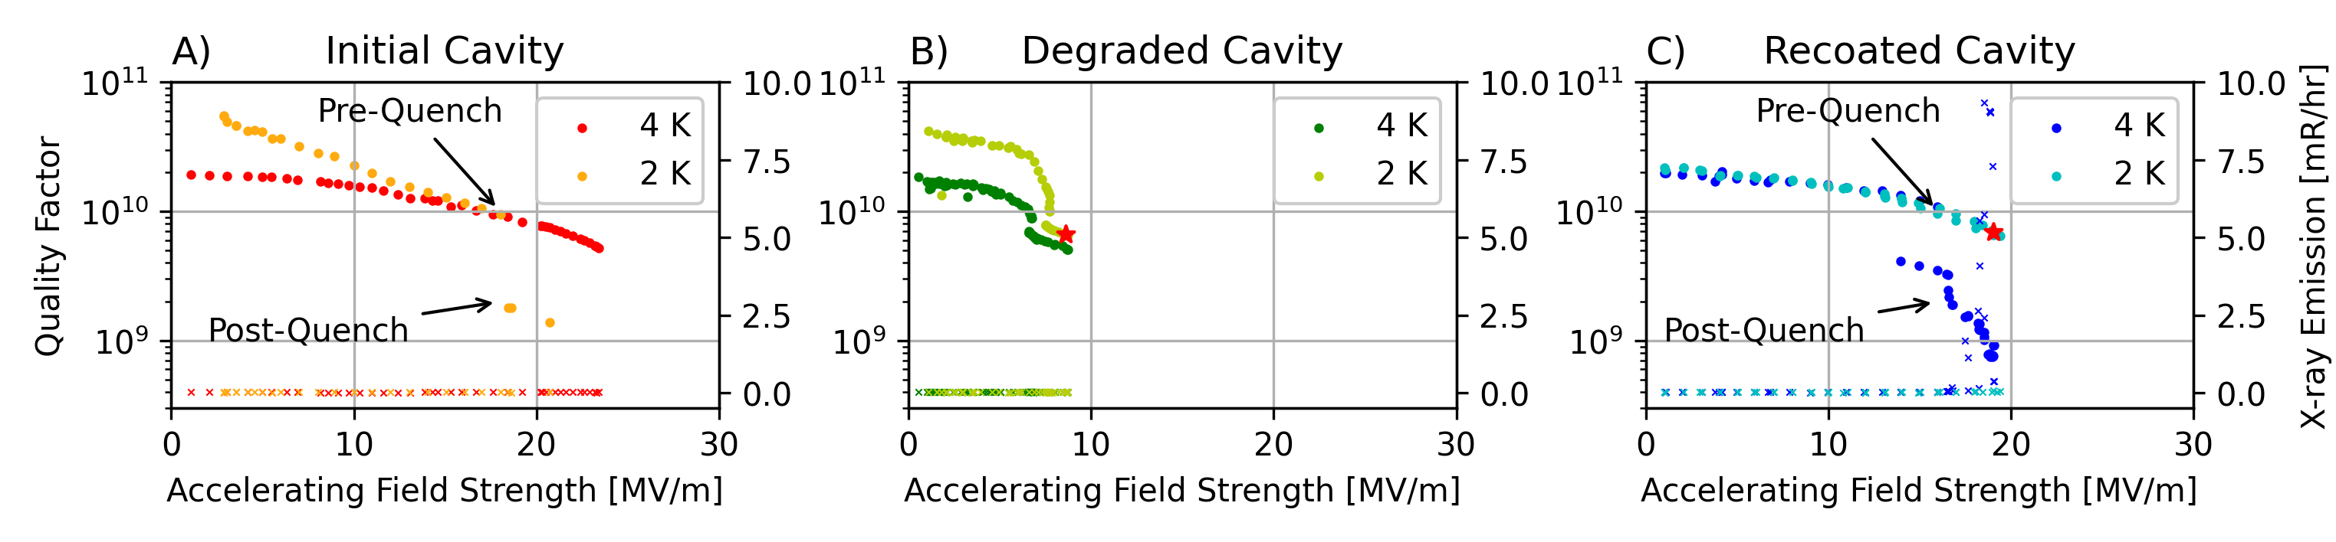
Recoating Heals Degraded Nb₃Sn Cavities
A second, light coating is required to improve performance.
1100 ℃ → 1000 ℃
5 h → 1 h
4 g of Sn → 0.85 g of Sn
Nb₃Sn cavity performance is degraded by strain.
Tuning
Assembly
Transportation

Slide 24
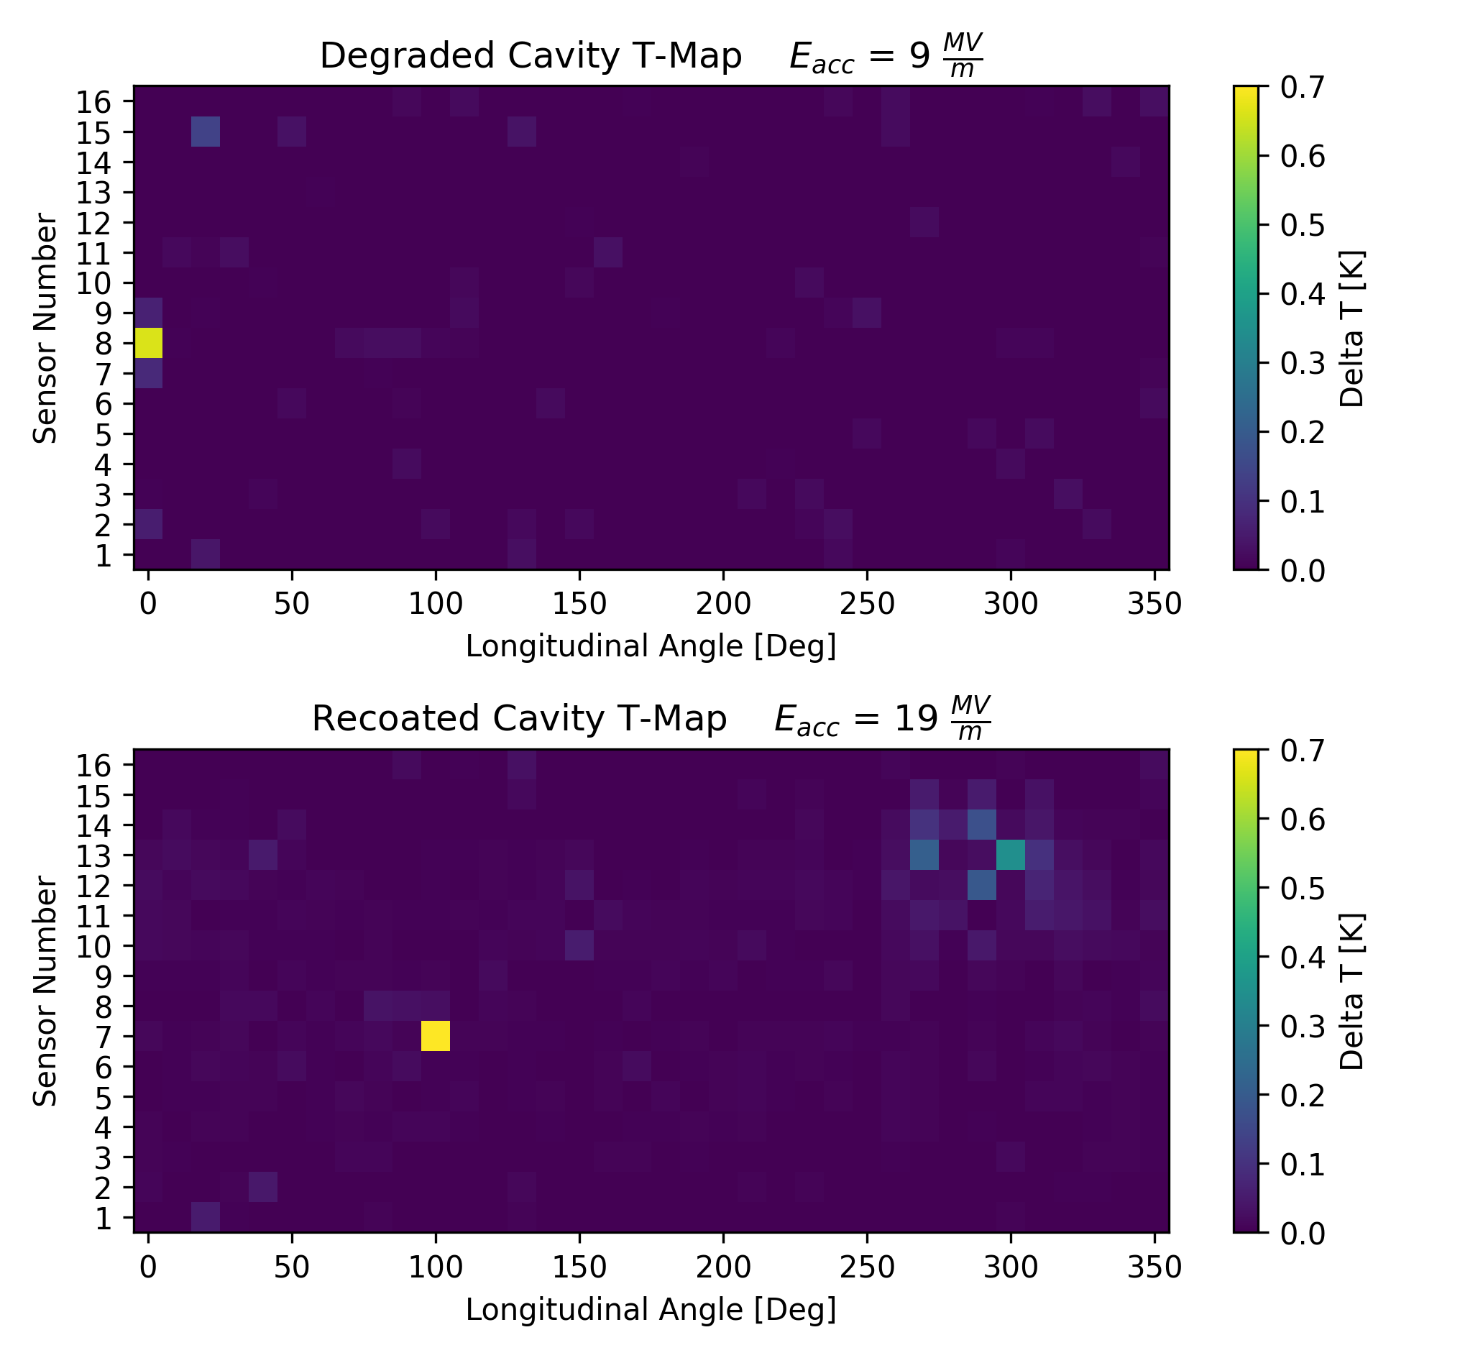
Recoated Cavity T-Map
Degraded cavity equator hotspot.
Recoating heals the defect causing the hotspot.

Slide 25
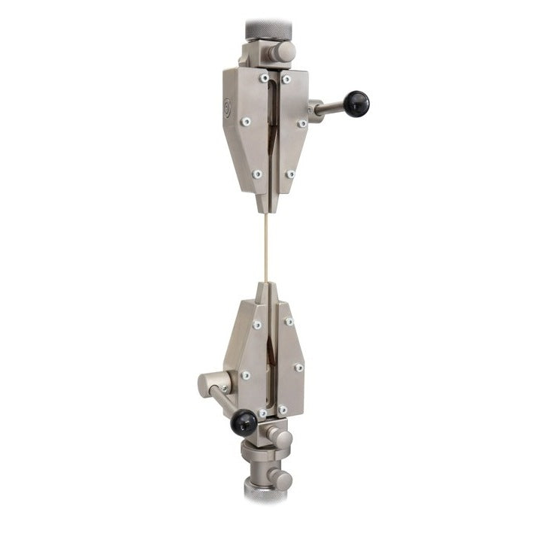
Finding the Mechanism of Nb₃Sn Cavity Healing
Strain applied to cavity causes cracks in Nb₃Sn coating.
Somehow the recoating can repair cracks.
Are the cracks being filled in?
Is the Nb₃Sn coating re-dissolving?
Is the new Nb₃Sn stoichiometric?
Nb₃Sn coated wires are used to study crack formation and healing.
0.1% to 0.5% elongation of the wire causes crack formation.

Slide 26
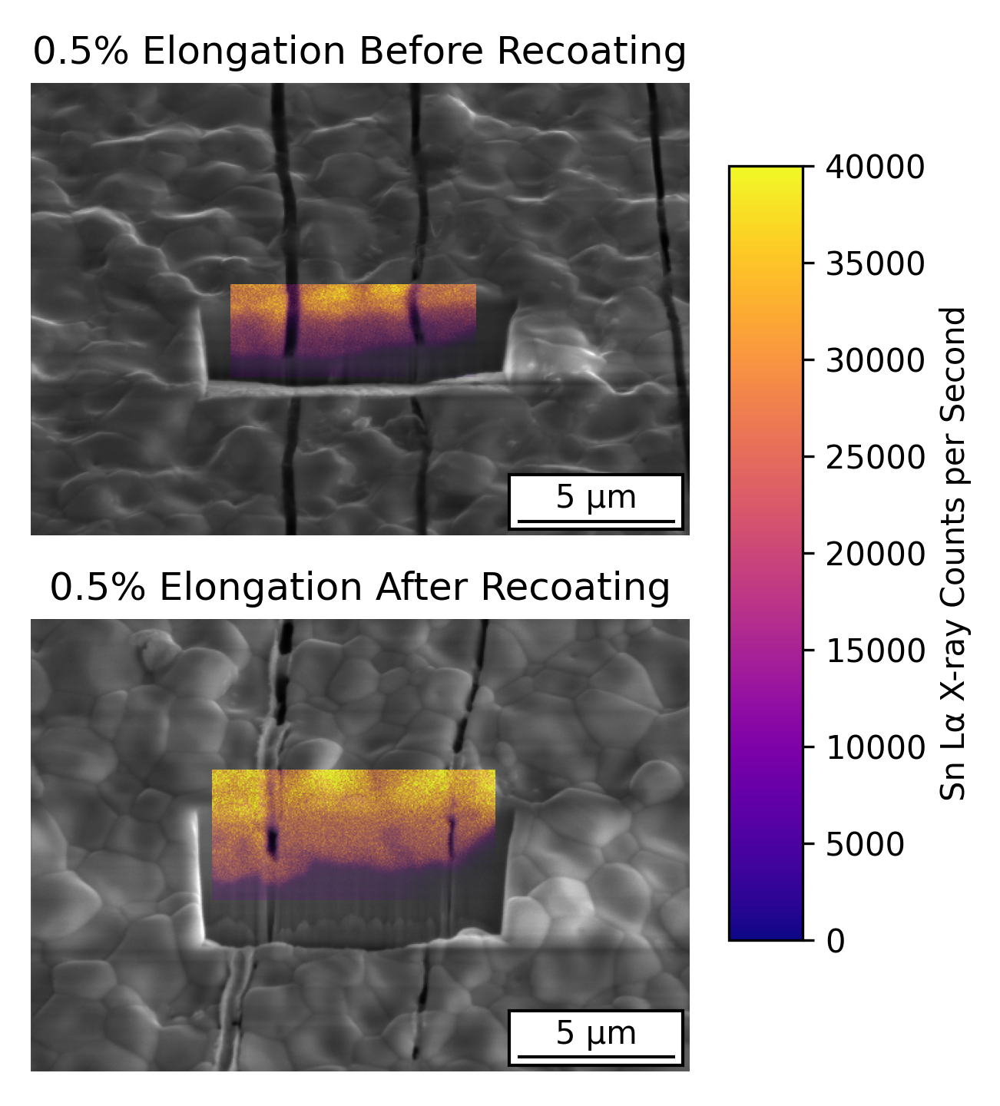
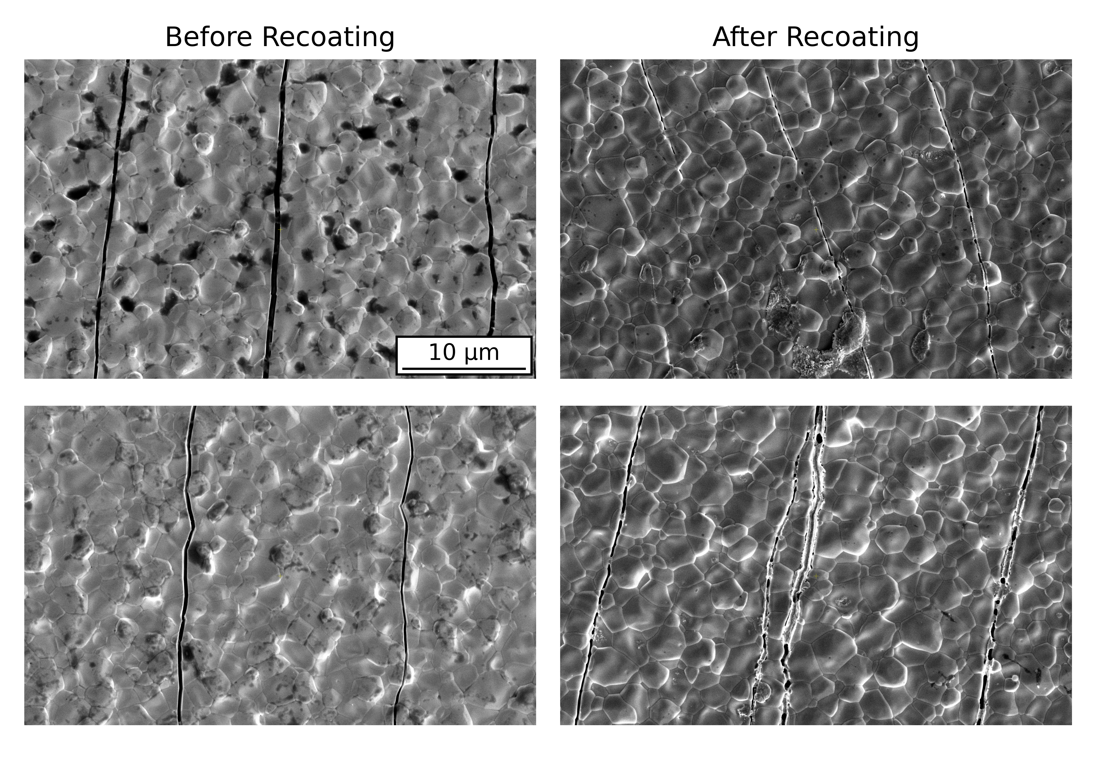
Results of Wire Study
New Nb₃Sn is formed in the crack and at the base of the crack in the Nb substrate.
New material is stoichiometric.

Slide 27
Research Proposal:
SRF Cavity Manufacturing Cost Reduction
Eric Viklund

Slide 28
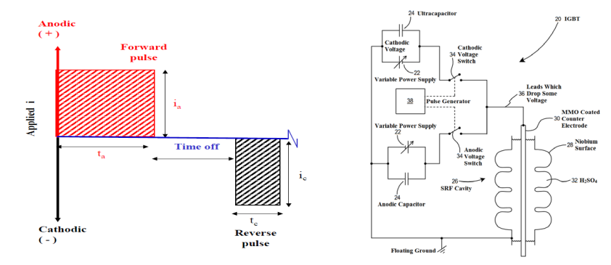
HF-Free Bipolar Electropolishing
HF-based EP
Environmental impact.
Human safety risk.
Increased costs.
Cost estimates for electropolishing with HF is $2,934 per cavity.¹
Polishing occurs through alternating anodic and cathodic pulses.
Bipolar EP
No HF required.
Neutral, non-toxic electrolyte
Cheaper
Tian, Hui, and Charles Reece. No. JLAB-ACC-19-3164; DOE/OR/23177-6266. Thomas Jefferson National Accelerator Facility (TJNAF), Newport News, VA (United States), 2019.

Slide 29
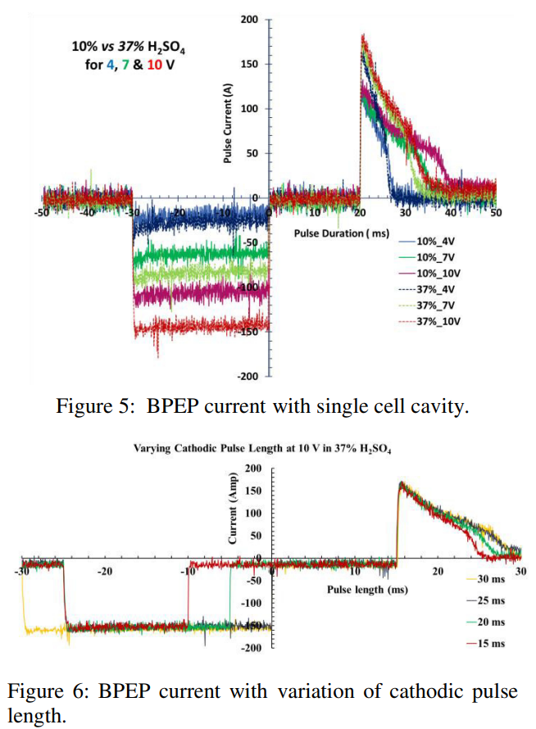
Bipolar Electropolishing Study
Bipolar EP has been shown to be effective by Faraday Technology, Inc., Cornell SRF group, KEK, and Jefferson Lab.
Removal rate is too slow.
120 hours to remove 64 μm¹
Removal rates are limited by power supply.
High currents during voltage pulse
Limited repetition rate
F. Furuta et al., in Proc. 18th Int. Conf. on RF Superconductivity (SRF'17), Lanzhou, China, July 2017, paper TUPB074, pp. 567-570, ISBN: 978-3-95450-191-5, https://doi.org/10.18429/JACoW-SRF2017-TUPB074, 2018.
Tian, Hui, et al. No. JLAB-ACC-18-2836; DOE/OR/23177-4574; TUPO043. Thomas Jefferson National Accelerator Facility (TJNAF), Newport News, VA (United States), 2019.

Slide 30
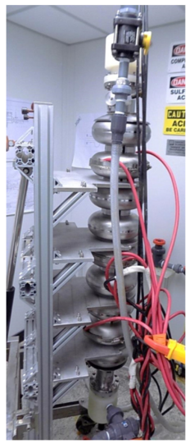
Plan of Study
Understand the Bipolar EP Chemical Mechanism
Electrochemical impedance spectroscopy
Sample study
Optimize the parameters of the bipolar EP based on new knowledge.
Higher removal rates.
Safe, neutral electrolyte
Utilize KEK’s vertical EP capabilities to develop a new multi-cell capable power supply.
High current density
High repetition rate

Slide 31

Research Experience
Material Analysis
HR-TEM
FIB/SEM
3D EDS/EBSD
Electrochemistry
Electrochemical impedance spectroscopy
Complex data analysis
SRF Technology
Cavity testing
Nb₃Sn coating
Electropolishing and Mechanical polishing
Publications
Viklund, Eric, et al. Superconductor Science and Technology 37.2 (2024): 025009.
Viklund, Eric, et al. APL Materials 12.7 (2024).
Viklund, E., et al. IEEE Transactions on Applied Superconductivity 33.5 (2023): 1-4.
Viklund, Eric, et al. No. FERMILAB-CONF-22-825-TD. Fermi National Accelerator Lab.(FNAL), Batavia, IL (United States), 2022.

